Slide 1
CORE MACHINE LEARNING FOUNDATIONS

Slide 2
TOPIC 1: Artificial Intelligence (AI)
This is the highest-level concept. Everything else (ML, DL, RL) comes under AI.
Definition
Artificial Intelligence (AI) is the ability of a computer or machine to perform tasks that normally require human intelligence.
In simple words: AI makes machines think and act like humans.
Why this concept exists
Computers were originally designed to follow strict instructions.
But many real-world problems require:
• Learning
• Reasoning
• Decision making
• Pattern recognition
AI allows machines to perform these intelligent tasks.

Slide 3
Real-life analogy
Human brain learns from experience.
AI allows machines to do the same.
Example: A child learns to recognize a dog.
AI learns to recognize a dog from images.
Mathematical Representation
AI can be represented as a function:
𝐴𝐼=𝑓(𝐼𝑛𝑝𝑢𝑡)→𝑂𝑢𝑡𝑝𝑢𝑡
Example: Image → AI → Dog detected
Explanation of symbols
Input = data given to AI
f = intelligent algorithm
Output = decision or prediction

Slide 4
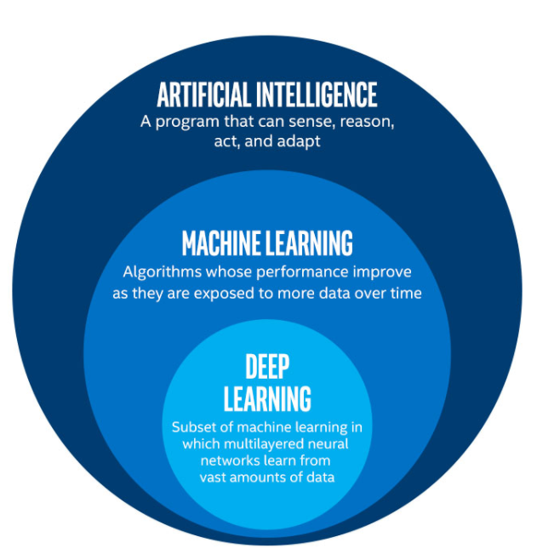
Visual explanation
Diagram: AI hierarchy
AI is the largest field.
ML and DL are subsets.
Practical example
Face recognition:
Input: image
AI output: identifies person
Types of AI
Narrow AI: Performs one specific task
Example: ChatGPT, Siri
General AI: Performs any human task (not achieved yet)
Super AI: More intelligent than humans (future concept)

Slide 5
Advantages
Automates tasks
Reduces human effort
Improves efficiency
Handles large data
Disadvantages
Expensive
Requires data
May make incorrect decisions
When to use
Automation
Prediction
Decision making
Robotics

Slide 6
When NOT to use
Simple rule-based problems
Example: Addition calculator does not need AI
Technical deep explanation
AI includes multiple techniques: Rule-based systems
Machine learning
Deep learning
Optimization algorithms
AI goal is to approximate intelligent function:𝑓(𝑥)≈ℎ𝑢𝑚𝑎𝑛𝑖𝑛𝑡𝑒𝑙𝑙𝑖𝑔𝑒𝑛𝑐𝑒
Summary
AI enables machines to simulate human intelligence.
Machine learning is a subset of AI.

Slide 7
TOPIC 2: Machine Learning (ML)
Definition
Machine Learning is a subset of AI that allows machines to learn from data without being explicitly programmed.
In simple words: Machine learning learns patterns from data.
Why this concept exists
Writing rules manually is difficult.
Example: Spam detection
Impossible to manually define all spam patterns.
Machine learning learns automatically.
Real-life analogy
Child learns from examples.
Show child many cats.
Child learns what a cat looks like.
Machine learning works the same way.

Slide 8
Mathematical Formula
Machine learning learns function:𝑦=𝑓(𝑥)
Explanation
x = input
y = output
f = learned function
Goal: Find best function f.
Practical example
House price prediction:
Input: house size
Output: price
ML learns relationship.
Types of Machine Learning
Supervised learning
Unsupervised learning
Reinforcement learning

Slide 9
Advantages
Learns automatically
Improves with more data
Handles complex patterns
Disadvantages
Needs data
Needs training
May overfit
When to use
Prediction
Classification
Clustering
Pattern recognition

Slide 10
When NOT to use
When no data exists
Simple fixed rules
Technical deep explanation
Machine learning solves optimization problem: min⁡𝐿𝑜𝑠𝑠(𝑦,𝑓(𝑥))
Model learns by minimizing loss function.
Summary
Machine learning learns patterns from data.
It is core of modern AI.

Slide 11
TOPIC 3: Deep Learning (DL)
Definition
Deep learning is a subset of machine learning that uses neural networks with multiple layers.
Why exists
Traditional ML struggles with complex data like images, video, speech.
Deep learning solves this.
Real-life analogy
Human brain uses neurons.
Deep learning uses artificial neurons.
Mathematical Formula
Neuron function:𝑦=𝑓(𝑤𝑥+𝑏)

Slide 12
Explanation
x = input
w = weight
b = bias
f = activation function
Practical example
Face recognition
Self-driving cars
Types
CNN
RNN
ANN
Advantages
High accuracy
Handles complex data

Slide 13
Disadvantages
Requires large data
Requires GPU
When to use
Image processing
Speech recognition
When NOT to use
Small dataset problems
Technical deep explanation
Deep networks approximate complex functions:𝑓(𝑥)=𝑓𝑛(𝑓𝑛−1(...𝑓1(𝑥)))
Summary
Deep learning uses neural networks.

Slide 14
TOPIC 4: Supervised Learning (SL)
This is the most commonly used type of machine learning.
Definition
Supervised learning is a type of machine learning where the model learns from labeled data.
Labeled data means input and correct output are both given.
Why this concept exists
We use supervised learning when correct answers are known.
Model learns mapping between input and output.

Slide 15
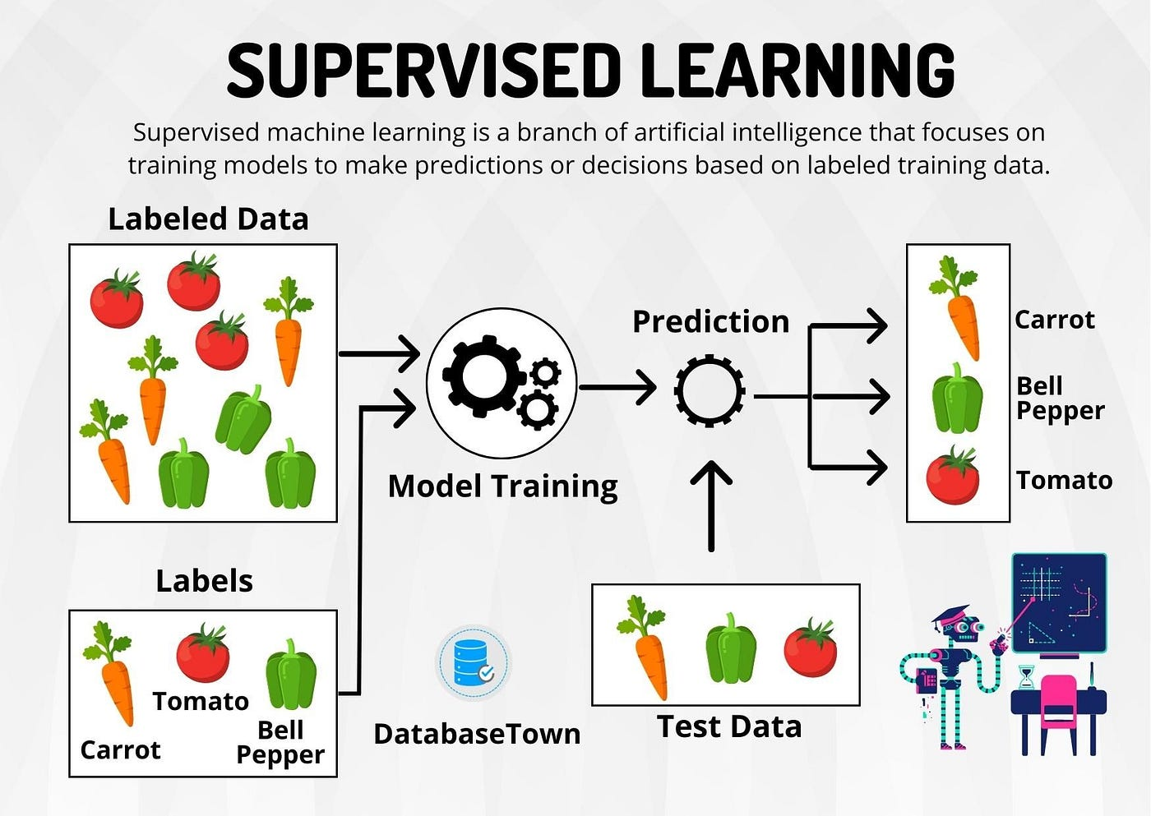
Real-life analogy
Teacher teaches student using solved examples.
Student learns pattern.
Mathematical Formula
𝑦=𝑓(𝑥)
Goal: Learn function f.
Explanation
x = input
y = output
f = learned function
Practical example
Input: house size
Output: house price
Model learns relationship.

Slide 16
Types
Regression
Classification
Advantages
Highly accurate
Widely used
Disadvantages
Requires labeled data
When to use
Prediction problems
Classification problems

Slide 17
When NOT to use
When labels unavailable
Technical deep explanation
Supervised learning minimizes loss function: min⁡𝐿𝑜𝑠𝑠(𝑦,𝑓(𝑥))
Summary
Supervised learning learns from labeled data.

Slide 18
TOPIC 5: Unsupervised Learning (USL)
Definition
Unsupervised learning learns patterns from unlabeled data.
No correct output is given.
Why exists
Labeling data is expensive.
Unsupervised learning finds hidden patterns automatically.
Real-life analogy
Grouping people based on similarity without knowing categories.

Slide 19
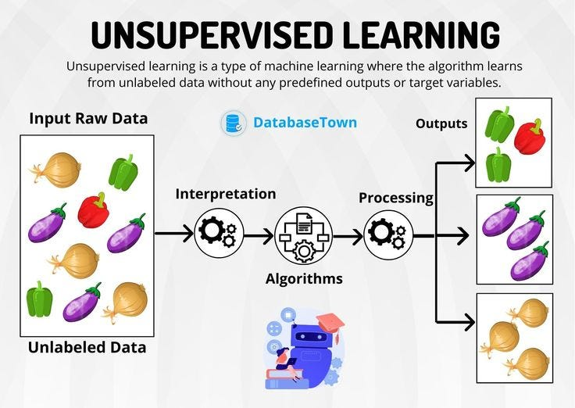
Mathematical goal
Find hidden structure: 𝑆𝑡𝑟𝑢𝑐𝑡𝑢𝑟𝑒=𝑓(𝑥)
Explanation
x = input data
No output provided
Practical example
Customer segmentation
Types
Clustering
Dimensionality reduction
Advantages
No labels needed
Find hidden patterns

Slide 20
Disadvantages
Hard to evaluate
When to use
Clustering
Pattern discovery
When NOT to use
When labels exist
Technical explanation
Optimizes similarity function.
Summary
Unsupervised learning finds patterns in unlabeled data.

Slide 21
TOPIC 6: Semi-Supervised Learning (SSL)
Definition
Semi-Supervised Learning is a type of machine learning that uses both labeled data and unlabeled data to train a model.
In simple words: The model learns from a small amount of correct answers and a large amount of unknown data.
Why this concept exists
Labeling data is expensive and time-consuming.
Example: Labeling medical images requires doctors.
But unlabeled data is abundant.
Semi-supervised learning allows models to use both efficiently.
This improves performance while reducing labeling cost.

Slide 22
Real-life analogy
Imagine a teacher gives:
• 10 solved math problems
• 100 unsolved problems
Student learns pattern from solved problems and applies it to unsolved problems.
Semi-supervised learning works exactly like this.
Mathematical Formula
Goal is to learn function: 𝑦=𝑓(𝑥) Using both: (𝑥𝑙,𝑦𝑙)(labeled data), (𝑥𝑢)(unlabeled data)
Total dataset:𝐷={(𝑥𝑙,𝑦𝑙),(𝑥𝑢)}
Explanation of symbols
x = input data
y = output label
(xl, yl) = labeled data
xu = unlabeled data
f = learned function
Goal: learn f using both labeled and unlabeled data.

Slide 23
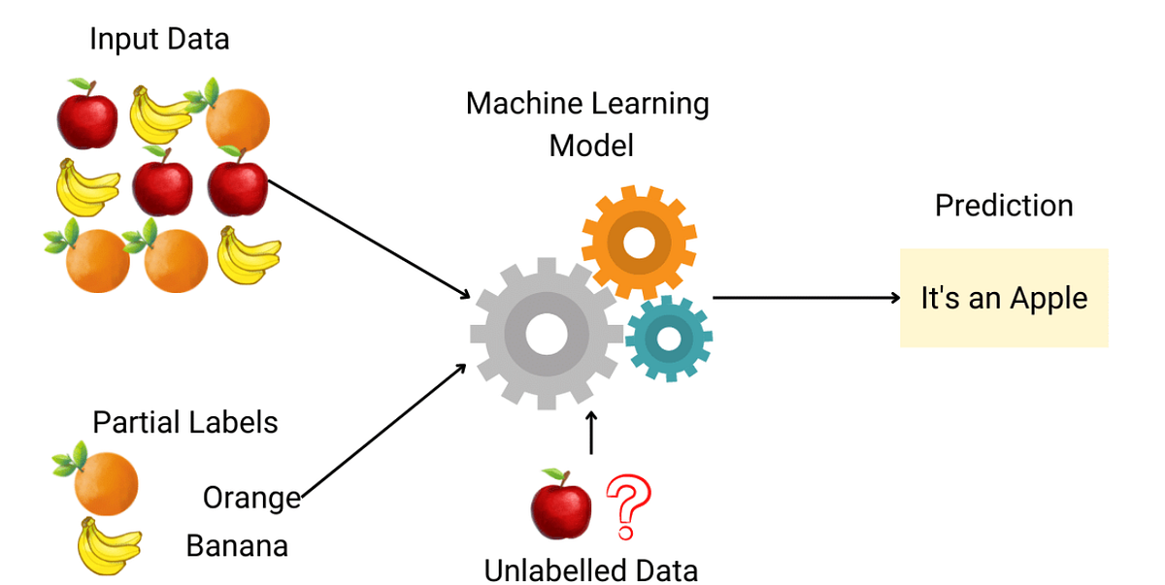
Visual explanation
Diagram: Semi-supervised learning process
Explanation: Small labeled dataset helps classify large unlabeled dataset.

Slide 24
Practical example
Email classification
Labeled data: 100 emails labeled spam/not spam
Unlabeled data: 10,000 unlabeled emails
Model learns from 100 labeled emails and improves using unlabeled emails.
Types:
Self-Training: Model predicts labels for unlabeled data and retrains.
Co-Training: Multiple models teach each other.
Graph-Based Methods: Uses similarity between data points.
Advantages
Requires fewer labeled data
Improves model accuracy
Uses large unlabeled datasets
Cost efficient
Disadvantages
May propagate incorrect labels
Complex implementation
Requires careful tuning

Slide 25
When to use
When labeled data is limited
When unlabeled data is abundant
Examples: Medical imaging, Speech recognition, Text classification
When NOT to use
When sufficient labeled data already exists
When unlabeled data is irrelevant
Slide 14: Technical deep explanation
Semi-supervised learning assumes: Similar inputs have similar outputs.
This is called the smoothness assumption.
Mathematically: If:𝑥1≈𝑥2, ​Then:𝑓(𝑥1)≈𝑓(𝑥2). This allows model to infer labels.
Summary
Semi-supervised learning uses both labeled and unlabeled data.
It improves accuracy while reducing labeling cost.
Very useful in real-world applications.

Slide 26
TOPIC 7: Reinforcement Learning (RL)
Reinforcement Learning is one of the most powerful and advanced machine learning paradigms. It is fundamentally different from supervised and unsupervised learning.
Definition
Reinforcement Learning is a type of machine learning where an agent learns by interacting with an environment and receiving rewards or punishments.
In simple words: The machine learns by trial and error.
Why this concept exists
Many real-world problems cannot be solved using fixed datasets.
Instead, machines must learn by interacting.
Examples:
• Self-driving cars
• Game playing (Chess, GTA, etc.)
• Robotics
Reinforcement learning allows machines to learn from experience.

Slide 27
Real-life analogy
Teaching a dog:
If dog performs correct action → reward
If wrong action → punishment
Dog learns correct behavior over time.
Machine learning agent works the same way.
Mathematical Formula
Goal of RL is to maximize total reward: max⁡∑𝑡=0∞𝛾𝑡𝑅𝑡
Explanation of symbols
t = time step
Rt = reward at time t
γ (gamma) = discount factor (importance of future reward)
γ ranges between 0 and 1If γ close to 1 → future rewards important
If γ close to 0 → only immediate rewards important

Slide 28
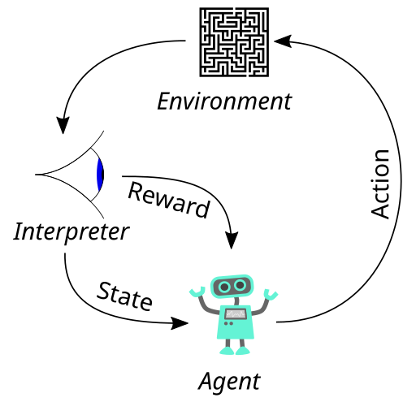
Visual explanation
Diagram: Reinforcement learning loop
Explanation: Agent → takes action → Environment → gives reward → agent learns
Practical example
Self-driving car:
Action: turn left
Environment: road
Reward: stays safe
Punishment: crash
Car learns safe driving.
Types
Model-based RL: Agent builds model of environment
Model-free RL: Agent learns directly from experience
Examples: Q-learning, Deep Q Network (DQN)

Slide 29
Advantages
Learns from interaction
Handles dynamic environments
No labeled data needed
Disadvantages
Slow learning
Requires many trials
Computationally expensive
When to use
Game playing
Robotics
Self-driving cars
Decision systems

Slide 30
When NOT to use
Static datasets
Simple prediction tasks
Technical deep explanation
Reinforcement learning follows Markov Decision Process (MDP):
Components: State (S), Action (A), Reward (R), Policy (π)
Goal: Learn optimal policy: 𝜋^∗=𝑜𝑝𝑡𝑖𝑚𝑎𝑙 𝑎𝑐𝑡𝑖𝑜𝑛
Summary
Reinforcement learning learns through trial and error using rewards.

Slide 31
TOPIC 8: Dataset
Dataset is the foundation of all machine learning. Without dataset, machine learning cannot exist.
Definition
A Dataset is a collection of data used to train and test machine learning models.
In simple words: Dataset is the information the machine learns from.
Why this concept exists
Machine learning learns patterns from data.
No data → no learning.
Dataset provides examples so model can learn relationships.
Real-life analogy
Dataset is like textbook for students.
Student learns from textbook.
Machine learns from dataset.

Slide 32
Mathematical Representation
Dataset is represented as: 𝐷={(𝑥1,𝑦1),(𝑥2,𝑦2),(𝑥3,𝑦3),...,(𝑥𝑛,𝑦𝑛)}
Explanation of symbols
D = dataset
x = input
y = output
n = total number of data points
Each pair (x,y) is called a data point.
Practical example
House price dataset:
Size Bedrooms Price
1000 2 50 lakh
1500 3 75 lakh
2000 4 1 crore
Dataset helps model learn price prediction.

Slide 33
Types
Training dataset: Used to train model
Validation dataset: Used to tune model
Test dataset: Used to evaluate model
Advantages
Provides learning examples
Improves model accuracy
Allows pattern recognition
Disadvantages
Poor quality dataset → poor model
Requires large data
When to use
Always required in machine learning

Slide 34
When NOT to use
Machine learning cannot exist without dataset
Technical deep explanation
Dataset defines function approximation problem:𝑓(𝑥)≈𝑦
Model learns mapping from dataset.
Dataset distribution determines model performance.
Summary
Dataset is collection of data used for training ML models.

Slide 35
TOPIC 9: Independent Variable (Feature / Predictor Variable)
Definition
Independent variable is the input variable used to predict output.
It is also called: Feature, Predictor variable, Input variable
Why this concept exists
Machine learning uses input variables to predict output.
These inputs determine model predictions.
Real-life analogy
Example: Predict salary using experience.
Experience = independent variable
Salary = dependent variable

Slide 36
Mathematical Representation
Independent variable represented as:𝑋, Multiple variables:𝑋=(𝑥1,𝑥2,𝑥3,...,𝑥𝑛)
Explanation
X = input
x₁, x₂, x₃ = individual features
Practical example
Predict house price:
Features: Size, Bedrooms, Location
These are independent variables.
Types
Continuous features
Categorical features
Binary features

Slide 37
Advantages
Provides prediction information
Improves model accuracy
Disadvantages
Irrelevant features reduce performance
When to use
Always used in ML prediction
When NOT to use
Never excluded
Technical deep explanation
Independent variables define input space: 𝑋∈𝑅𝑛
Model learns mapping:𝑓(𝑋)→𝑌
Summary
Independent variable is input to ML model.

Slide 38
TOPIC 10: Dependent Variable (Target Variable)
Definition
Dependent variable is the output the model predicts.
It depends on independent variables.
Why exists
Machine learning predicts dependent variable.
Real-life analogy
Predict exam marks:
Study hours = independent
Marks = dependent

Slide 39
Mathematical Representation
Represented as: 𝑌
Explanation
Y = output variable
Practical example
House price prediction:
Price = dependent variable
Types
Continuous output
Categorical output
Advantages
Defines prediction goal

Slide 40
Disadvantages
Incorrect target → incorrect model
When to use
Supervised learning
When NOT to use
Unsupervised learning
Technical deep explanation
Model learns function: 𝑌=𝑓(𝑋)
Summary
Dependent variable is predicted output.

Slide 41
TOPIC 11: Labeled Data
Definition
Labeled data is data where both the input and the correct output are already known.
In simple words: The dataset contains questions and correct answers.
Why this concept exists
Machine learning models learn by comparing their predictions with correct answers.
Labeled data provides the correct answers.
Without labeled data, supervised learning cannot work.
Real-life analogy
Teacher gives student:
Question: 2 + 2
Answer: 4
Student learns from correct answer.
Machine learning works the same way.

Slide 42
Mathematical Representation
Labeled dataset:𝐷={(𝑥1,𝑦1),(𝑥2,𝑦2),...,(𝑥𝑛,𝑦𝑛)}
Explanation of symbols
D = dataset
x = input
y = correct output label
(x,y) = labeled data point
Practical example
Spam detection dataset:
Email Text Label
Buy now Spam
Hello friend Not Spam
Model learns from labeled examples.
Types
Regression labels (numeric), Example: price prediction
Classification labels (categories), Example: spam / not spam

Slide 43
Advantages
Highly accurate learning
Clear supervision
Easy model evaluation
Disadvantages
Expensive to create
Requires human effort
Time consuming
When to use
Supervised learning
Prediction tasks
Classification tasks

Slide 44
When NOT to use
When labels unavailable
Use unsupervised learning instead.
Technical deep explanation
Labeled data allows supervised learning optimization:min⁡𝐿𝑜𝑠𝑠(𝑦,𝑓(𝑥))
Model compares predicted output with true label.
Summary
Labeled data contains both inputs and correct outputs.
Required for supervised learning.

Slide 45
TOPIC 12: Regression
Definition
Regression is a type of supervised learning used to predict continuous numerical values.
In simple words: Regression predicts numbers.
Why this concept exists
Many real-world problems require predicting numbers.
Examples:
House price prediction
Temperature prediction
Stock price prediction
Real-life analogy
Predict salary based on experience.
Experience = input
Salary = output number

Slide 46
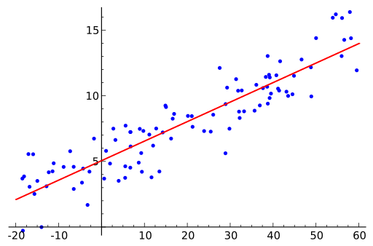
Mathematical Formula
Basic regression equation:𝑌=𝑓(𝑋)
Linear regression form: 𝑌=𝑤𝑋+𝑏
Explanation of symbols
Y = predicted output
X = input
w = weight
b = bias
f = function learned by model
Visual explanation
Diagram: regression line
Practical example
Predict house price using size.
Size = input
Price = numeric output

Slide 47
Types
Linear regression
Polynomial regression
Ridge regression
Lasso regression
Advantages
Predicts continuous values
Simple and interpretable
Disadvantages
Cannot predict categories
Sensitive to outliers
When to use
Numeric prediction problems

Slide 48
When NOT to use
Categorical prediction problems
Use classification instead.
Technical deep explanation
Regression minimizes loss function:𝐿𝑜𝑠𝑠=∑(𝑦−𝑦^)^2
Model finds best function f.
Summary
Regression predicts continuous numerical values.

Slide 49
TOPIC 13: Classification
Definition
Classification predicts categories or classes.
Why exists
Many problems require predicting categories.
Examples: Spam detection, Disease detection
Real-life analogy
Predict gender: Male or Female
Mathematical Representation
𝑌∈{𝐶𝑙𝑎𝑠𝑠1,𝐶𝑙𝑎𝑠𝑠2,...,𝐶𝑙𝑎𝑠𝑠𝑁}
Explanation
Output is category, not number.

Slide 50
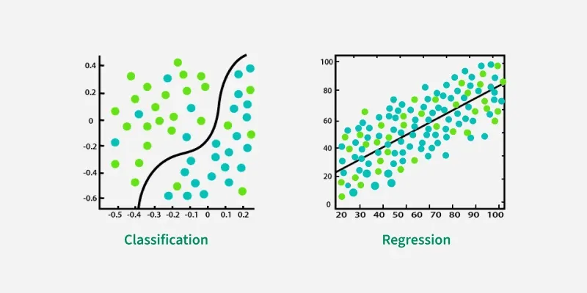
Visual explanation
Practical example
Email spam detection.
Types
Binary classification
Multi-class classification
Advantages
Useful in many applications
Disadvantages
Cannot predict exact numbers

Slide 51
When to use
Category prediction
When NOT to use
Numeric prediction problems
Technical explanation
Classification learns decision boundary.
Summary
Classification predicts categories

Slide 52
TOPIC 14: Clustering
Definition
Clustering is a type of machine learning where similar data points are grouped together into clusters.
In simple words: Clustering automatically finds groups in data based on similarity.
No labels are required.
Why this concept exists
In many real-world situations, data does not have labels.
We need a way to discover hidden patterns.
Clustering helps to:
• Group similar customers
• Detect fraud
• Segment images
• Discover hidden structures
Clustering is a type of unsupervised learning.

Slide 53
Real-life analogy
Imagine sorting fruits.
You are given mixed fruits: Apples, Bananas, Oranges
Without labels, you group them based on similarity.
Machine learning clustering works the same way.
Mathematical Formula
Clustering tries to minimize distance within clusters:
min⁡∑𝑖=1𝑘∑𝑥∈𝐶𝑖𝑑𝑖𝑠𝑡𝑎𝑛𝑐𝑒(𝑥,𝐶𝑖)
Explanation of symbols
k = number of clusters
Ci = cluster I
x = data point
distance(x, Ci) = distance between point and cluster center
Goal: Minimize distance inside cluster. Maximize distance between clusters.

Slide 54
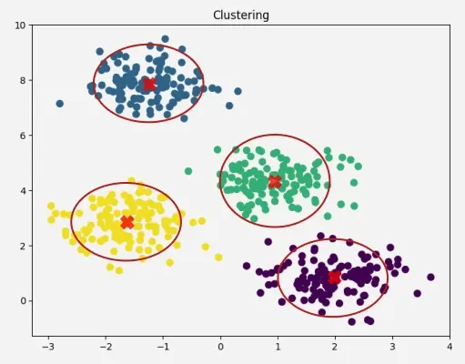
Visual explanation
Diagram: Clustering of data points
Explanation: Points automatically form groups based on similarity.
Each color represents a cluster.
Practical example
Customer segmentation:
Dataset contains: Age, Income, Spending
Clustering groups customers into: High-value customers, Medium-value customers, Low-value customers
Businesses use this for marketing.
Types of Clustering Algorithms
Most important clustering algorithms:
K-Means Clustering: Groups data into k clusters
Hierarchical Clustering: Creates tree-like clusters
DBSCAN: Groups based on density
Mean Shift Clustering

Slide 55
Advantages
Does not require labeled data
Finds hidden patterns
Useful for exploratory analysis
Works automatically
Disadvantages
Choosing correct number of clusters can be difficult
Sensitive to distance metric
May not work well with complex shapes
When to use
Customer segmentation
Image segmentation
Market analysis
Pattern discovery
Fraud detection

Slide 56
When NOT to use
When labeled data is available
In that case, supervised learning is better.
Technical deep explanation
Clustering works using distance metrics:
Most common distance: Euclidean distance:𝑑=(𝑥1−𝑥2)^2+(𝑦1−𝑦2)^2 Clustering algorithms try to minimize intra-cluster distance: Intra-cluster distance=𝑠𝑚𝑎𝑙𝑙 And maximize inter-cluster distance: Inter-cluster distance=𝑙𝑎𝑟𝑔𝑒. This creates clear group separation.
Summary
Clustering is unsupervised learning technique.
It groups similar data automatically.
Used for discovering hidden patterns.

Slide 57
TOPIC 15: Binary Variable
Binary variables are extremely important because many machine learning problems involve yes/no decisions.
Definition
A Binary Variable is a variable that has only two possible values.
In simple words: Binary means only two options.
Why this concept exists
Many real-world problems have only two possible outcomes.
Examples: Spam or Not Spam, Yes or No, True or False, 0 or 1
Machine learning models use binary variables frequently.
Real-life analogy
Light switch: ON or OFF
Only two states exist.
Binary variable works the same way.

Slide 58
Mathematical Representation
Binary variable takes values: 𝑋∈{0,1}
Explanation of symbols
X = variable
0 = one category
1 = second category
Example: 0 = No, 1 = Yes
Practical example
Spam detection: Spam = 1, Not Spam = 0
Types
Numeric binary variable: 0 and 1
Logical binary variable: True and False

Slide 59
Advantages
Simple
Easy to process
Efficient computation
Disadvantages
Limited information
Only two states
When to use
Binary classification
Decision making
Logistic regression

Slide 60
When NOT to use
More than two categories exist
Use categorical variable instead.
Technical deep explanation
Binary variables are used in logistic regression: 𝑃(𝑌=1∣𝑋)
Model predicts probability of class 1.
Summary
Binary variable has only two values.
Common in classification problems.

Slide 61
TOPIC 16: Categorical Variable
Categorical variables are extremely important in ML because many real-world features are categorical.
Definition
Categorical variable is a variable that represents categories or groups.
It can have more than two possible values.
Why this concept exists
Many real-world variables are categories.
Examples:
Color: Red, Blue, Green
City: Ahmedabad, Mumbai, Delhi
Machine learning needs to handle categorical data.

Slide 62
Real-life analogy
Traffic signal: Red, Yellow, Green
These are categorical values.
Mathematical Representation
Categorical variable:𝑋∈{𝐶𝑎𝑡𝑒𝑔𝑜𝑟𝑦1,𝐶𝑎𝑡𝑒𝑔𝑜𝑟𝑦2,...,𝐶𝑎𝑡𝑒𝑔𝑜𝑟𝑦𝑛}
Explanation
X = categorical variable
Categories = possible values
Practical example
Customer city: Ahmedabad, Mumbai, Delhi
Types
Nominal variable: No order, Example: colors
Ordinal variable: Ordered categories, Example: Low, Medium, High

Slide 63
Advantages
Represents real-world categories
Easy interpretation
Disadvantages
Must convert into numbers for ML
When to use
Classification problems
Feature representation
When NOT to use
When numeric value needed

Slide 64
Technical deep explanation
Categorical variables must be encoded
Example:
One-hot encoding:
Red = (1,0,0)
Blue = (0,1,0)
Green = (0,0,1)
Summary
Categorical variable represents categories.

Slide 65
TOPIC 17: Continuous Variable
Continuous variables are essential in regression problems.
Definition
Continuous variable can take infinite numeric values.
Why exists
Many real-world measurements are continuous.
Examples: Height, Weight, Temperature
Real-life analogy
Height can be: 170.1 cm, 170.12 cm, 170.123 cm
Infinite possibilities.

Slide 66
Mathematical Representation
Continuous variable:𝑋∈𝑅
Explanation
ℝ = real numbers
Continuous variable can take any real number.
Practical example
House price prediction
Price is continuous.
Types
Positive continuous
Negative continuous
Advantages
Precise measurement
Useful in regression

Slide 67
Disadvantages
Sensitive to noise
When to use
Regression problems
When NOT to use
Categorical problems
Technical explanation
Continuous variables define infinite feature space.
Summary
Continuous variables take infinite numeric values.

Slide 68
TOPIC 18: Bias
Definition
Bias is the error caused by the model making overly simple assumptions about the data.
In simple words: Bias happens when the model is too simple to learn the real pattern.
Why this concept exists
Machine learning models try to learn patterns.
If the model is too simple, it cannot capture the true relationship.
This creates systematic error called bias.
Real-life analogy
Imagine drawing a straight line to fit curved data.
Straight line cannot capture curve.
This error is bias.

Slide 69
Mathematical Formula
Bias is defined as: 𝐵𝑖𝑎𝑠=𝐸[𝑦^]−𝑦
Explanation of symbols
Bias = error due to wrong assumptions
E[ŷ] = expected prediction
y = true value
Difference between predicted and true value = bias
Practical example
Predict house price using only number of bedrooms.
Ignoring location creates bias.
Model becomes inaccurate.
Types
High bias
Low bias

Slide 70
Advantages of High Bias
Simple models
Fast training
Less computation
Disadvantages of High Bias
Poor accuracy
Underfitting
Misses real patterns
When to use high bias models
Simple problems
Small datasets

Slide 71
When NOT to use high bias models
Complex datasets
Nonlinear problems
Technical deep explanation
High bias occurs when: Model assumption is too simple.
Example: Linear regression on nonlinear data.
Mathematically:𝑓(𝑥)≠𝑡𝑟𝑢𝑒 𝑓𝑢𝑛𝑐𝑡𝑖𝑜𝑛
Summary
Bias is error caused by overly simple models.
High bias leads to underfitting.

Slide 72
TOPIC 19: Variance
Variance is the opposite of bias.
Definition
Variance is the error caused by the model being too sensitive to training data.
In simple words: Model memorizes data instead of learning pattern.
Why this concept exists
If model is too complex, it learns noise instead of pattern.
This causes poor performance on new data.
Real-life analogy
Student memorizes answers instead of understanding concept.
Fails in new questions.

Slide 73
Mathematical Formula
Variance is defined as: 𝑉𝑎𝑟𝑖𝑎𝑛𝑐𝑒=𝐸[(𝑦^−𝐸[𝑦^])2]
Explanation
ŷ = predicted value
E[ŷ] = expected prediction
Variance measures prediction variability.
Practical example
Very complex model memorizes training data.
Fails on test data.
Types
High variance
Low variance
Advantages of Low Variance
Stable predictions
Better generalization

Slide 74
Disadvantages of High Variance
Overfitting
Poor generalization
When high variance occurs
Complex models
Small datasets
When low variance occurs
Simple models
Large datasets
Technical deep explanation
Variance measures sensitivity to training data changes.
High variance models: 𝑓𝑡𝑟𝑎𝑖𝑛(𝑥)≠𝑓𝑡𝑒𝑠𝑡(𝑥)
Summary
Variance measures model sensitivity.
High variance leads to overfitting.

Slide 75
TOPIC 20: Bias–Variance Tradeoff
It explains why some models underfit and others overfit, and how to find the optimal balance.
Definition
The Bias–Variance Tradeoff is the balance between:
• Bias (error from overly simple model)
• Variance (error from overly complex model)
In simple words: We must find the model that is neither too simple nor too complex.
Why this concept exists
If model is too simple → High Bias → Underfitting
If model is too complex → High Variance → Overfitting
Machine learning must balance both to achieve best performance.

Slide 76
Real-life analogy
Learning for exam:
Case 1: Study too little → poor understanding → High bias
Case 2: Memorize exact questions → fail new questions → High variance
Best case: Understand concepts properly → Balanced learning
Mathematical Formula
Total error consists of:
𝑇𝑜𝑡𝑎𝑙 𝐸𝑟𝑟𝑜𝑟=𝐵𝑖𝑎𝑠2+𝑉𝑎𝑟𝑖𝑎𝑛𝑐𝑒+𝐼𝑟𝑟𝑒𝑑𝑢𝑐𝑖𝑏𝑙𝑒 𝐸𝑟𝑟𝑜𝑟
Explanation of symbols
Bias² = error from wrong assumptions
Variance = error from sensitivity to training data
Irreducible error = noise that cannot be removed
Total error = sum of all errors
Goal of ML: Minimize total error.

Slide 77
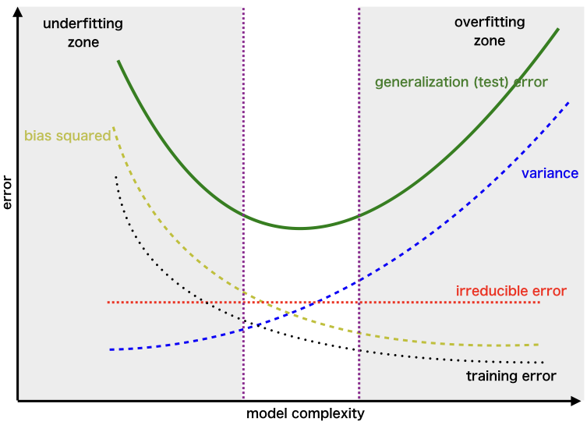
Visual explanation
Diagram: Bias-Variance tradeoff curve
Explanation:
Left side = High bias, low variance
Right side = Low bias, high variance
Middle = optimal model
Practical example
Polynomial regression
Degree 1 (line) → High bias
Degree 20 → High variance
Degree 3 → Balanced model

Slide 78
Types of situations
High Bias, Low Variance, Example: Linear regression
Low Bias, High Variance, Example: Deep neural network
Balanced Bias and Variance, Example: Random Forest
Advantages of proper balance
Best prediction accuracy
Good generalization
Optimal model performance
Disadvantages of imbalance
High bias → underfitting
High variance → overfitting
Poor performance

Slide 79
When to use this concept
Always used when designing ML models
Model selection
Hyperparameter tuning
When NOT to use
Never ignored in ML
Always important.
Technical deep explanation
Expected prediction error: 𝐸[(𝑦−𝑦^)2]=𝐵𝑖𝑎𝑠2+𝑉𝑎𝑟𝑖𝑎𝑛𝑐𝑒+𝑁𝑜𝑖𝑠𝑒
Machine learning tries to minimize this expected error.
This defines optimal model complexity.
Summary
Bias–Variance tradeoff determines optimal model complexity.
Best model balances bias and variance.

Slide 80
TOPIC 21: Overfitting
Definition
Overfitting occurs when a model learns training data too well, including noise.
In simple words: Model memorizes instead of learning.
Why this concept exists
When model is too complex, it learns noise.
It performs well on training data but poorly on new data.
Real-life analogy
Student memorizes answers instead of understanding concepts.
Fails when questions change.

Slide 81
Mathematical Representation
Training error: 𝐸𝑟𝑟𝑜𝑟𝑡𝑟𝑎𝑖𝑛=𝑣𝑒𝑟𝑦 𝑙𝑜𝑤
Test error: 𝐸𝑟𝑟𝑜𝑟𝑡𝑒𝑠𝑡=𝑣𝑒𝑟𝑦 ℎ𝑖𝑔ℎ
Explanation
Training error = error on training data
Test error = error on new data
Large difference indicates overfitting.
Practical example
Model memorizes exact house prices.
Fails on new houses.

Slide 82
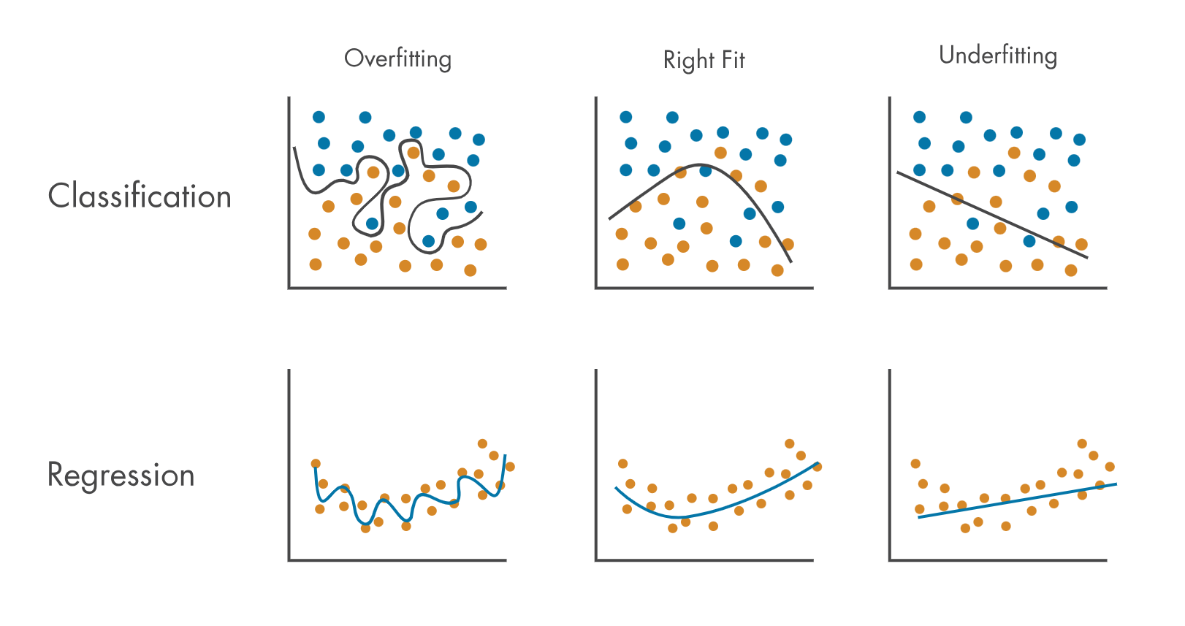
Causes
Complex models
Small datasets
Noise in data
Too many features
Advantages
Very accurate on training data
Disadvantages
Poor real-world performance
Poor generalization
When overfitting occurs
Complex models
Deep neural networks
Small datasets
Explanation:Straight line cannot fit curved data

Slide 83
How to prevent overfitting
Use more data
Use regularization
Use simpler model
Use cross-validation
Technical deep explanation
Overfitting occurs when:
𝑉𝑎𝑟𝑖𝑎𝑛𝑐𝑒>>𝐵𝑖𝑎𝑠
Model learns noise instead of true function.
Summary
Overfitting is caused by overly complex models.

Slide 84
TOPIC 22: Underfitting
Underfitting is the opposite of overfitting. It occurs when the model is too simple to learn the real pattern in data.
Definition
Underfitting occurs when a model is too simple and cannot learn the underlying pattern of the data.
In simple words: The model fails to learn properly.
Why this concept exists
Machine learning models try to learn patterns.
If the model is too simple, it cannot capture complex relationships.
This causes poor performance on both training and test data.
Real-life analogy
Student studies very little and does not understand subject.
Fails both practice tests and real exams.

Slide 85
Mathematical Representation
Training error: 𝐸𝑟𝑟𝑜𝑟𝑡𝑟𝑎𝑖𝑛=ℎ𝑖𝑔ℎ
Test error:𝐸𝑟𝑟𝑜𝑟𝑡𝑒𝑠𝑡=ℎ𝑖𝑔ℎ
Explanation of symbols
Errortrain = error on training data
Errortest = error on test data
Both errors are high in underfitting.
Practical example
Using linear regression for nonlinear data.
Model cannot capture curve.
Causes
Model too simple
Too few features
Insufficient training

Slide 86
Advantages
Simple models
Fast training
Disadvantages
Poor accuracy
Fails to learn pattern
When underfitting occurs
Simple models
Complex data
How to fix underfitting
Use more complex model
Add more features
Train longer
Use nonlinear models

Slide 87
Technical deep explanation
Underfitting occurs when:𝐵𝑖𝑎𝑠>>𝑉𝑎𝑟𝑖𝑎𝑛𝑐𝑒
Model cannot approximate true function:𝑓(𝑥)≠𝑡𝑟𝑢𝑒 𝑓𝑢𝑛𝑐𝑡𝑖𝑜𝑛
Summary
Underfitting happens when model is too simple.

Slide 88
TOPIC 23: Residual
Definition
Residual is the difference between actual value and predicted value.
In simple words: Residual = prediction error.
Why this concept exists
Machine learning predictions are not perfect.
Residual measures prediction error.
It helps evaluate model performance.
Real-life analogy
Actual price: ₹100
Predicted price: ₹90
Residual = ₹10

Slide 89
Mathematical Formula
𝑅𝑒𝑠𝑖𝑑𝑢𝑎𝑙=𝑦−𝑦^
Explanation of symbols
y = actual value
ŷ = predicted value
Residual = difference between actual and predicted.
Practical example
Actual price = 500000
Predicted price = 480000
Residual = 20000
Types
Positive residual
Negative residual

Slide 90
Advantages
Helps evaluate model accuracy
Used in loss functions
Disadvantages
Large residual indicates poor prediction
When to use
Regression analysis
Model evaluation
When NOT to use
Classification problems
Technical deep explanation
Loss functions use residual: 𝑀𝑆𝐸=1/𝑛*∑(𝑦−𝑦^)^2
Model tries to minimize residual.
Summary
Residual is prediction error.

Slide 91
TOPIC 24: Hyperparameter
Hyperparameters are one of the most critical concepts in machine learning because they control how the model learns.
Definition
A Hyperparameter is a parameter that is set before training the model and controls how the model learns.
In simple words: Hyperparameter controls the learning process, not the prediction.
Why this concept exists
Machine learning models need configuration settings.
These settings control:
• Model complexity
• Learning speed
• Model behavior
Hyperparameters allow us to optimize model performance.
Real-life analogy
Cooking example: Hyperparameters = cooking settings, Temperature, Cooking time
These affect final food quality.

Slide 92
Mathematical Representation
Example: Linear regression with regularization:𝐿𝑜𝑠𝑠=∑(𝑦−𝑦^)^2+𝜆∑𝑤^2
Explanation of symbols
λ (lambda) = hyperparameter
Controls strength of regularization
w = model weights
Higher λ → simpler model
Lower λ → complex model
Practical example
KNN algorithm
Hyperparameter = K (number of neighbors)
K = 1 → very sensitive
K = 10 → smoother predictions

Slide 93
Common hyperparameters
Learning rate
Number of epochs
Number of layers
Regularization parameter
Number of neighbors (K)
Advantages
Improves model performance
Allows optimization
Controls overfitting
Disadvantages
Difficult to select
Requires experimentation

Slide 94
When to use
Always used in ML model training
When NOT to use
Cannot avoid hyperparameters
Technical deep explanation
Hyperparameters control optimization process:
Example:
Gradient descent:𝑤=𝑤−𝛼∇𝐿𝑜𝑠𝑠
α (alpha) = learning rate hyperparameter
Summary
Hyperparameters control model learning behavior.

Slide 95
TOPIC 25: Cross Validation
Cross-validation is one of the most important techniques to evaluate and improve machine learning models.
Definition
Cross-validation is a technique used to evaluate model performance using multiple training and testing splits.
In simple words: Model is tested multiple times to ensure reliability.
Why this concept exists
Single train-test split may give misleading results.
Cross-validation provides reliable performance estimate.
Real-life analogy
Student gives multiple mock tests before final exam.
This gives better performance estimate.

Slide 96
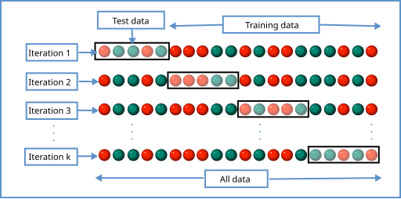
Mathematical Representation
Dataset split into K parts:𝐷={𝐷1,𝐷2,...,𝐷𝐾}
Train on K−1 parts, test on remaining part.
Repeat K times.
Explanation
D = dataset
K = number of folds
Each fold acts as test set once.
Visual explanation
Diagram: K-fold cross validation
Practical example
5-fold cross validation:
Split data into 5 parts.
Train on 4, test on 1.
Repeat 5 times.

Slide 97
Types
K-fold cross validation
Stratified cross validation
Leave-one-out cross validation
Advantages
Reliable performance estimate
Reduces overfitting
Better model evaluation
Disadvantages
Computationally expensive
Slow training

Slide 98
When to use
Model evaluation
Hyperparameter tuning
When NOT to use
Very large datasets (expensive)
Technical deep explanation
Final performance:𝐴𝑐𝑐𝑢𝑟𝑎𝑐𝑦=1/𝐾*∑𝐴𝑐𝑐𝑢𝑟𝑎𝑐𝑦𝑖
​Average accuracy across folds.
Summary
Cross-validation provides reliable model evaluation.

Slide 99
TOPIC 26: Convex Function
Convex functions are extremely important because machine learning optimization works best when the loss function is convex.
Definition
A Convex Function is a function where the line connecting any two points on the graph lies above or on the graph.
In simple words: Convex function has a bowl shape.
It has only one minimum point.
Why this concept exists
Machine learning tries to minimize loss function.
If loss function is convex:
• Easy to find minimum
• No risk of getting stuck in wrong minimum
Convex functions guarantee optimal solution.
Real-life analogy
Imagine a smooth bowl.
Ball placed anywhere will roll to bottom.
Bottom = minimum point
Convex function behaves the same way.

Slide 100
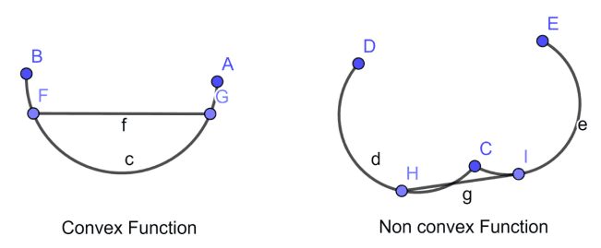
Mathematical Formula
Convex function definition: 𝑓(𝜆𝑥1+(1−𝜆)𝑥2)≤𝜆𝑓(𝑥1)+(1−𝜆)𝑓(𝑥2)
Explanation of symbols
f = function
x₁, x₂ = two points
λ = value between 0 and 1
This ensures bowl-shaped curve.
Visual explanation
Diagram: Convex vs Non-convex function
Explanation:Convex function has single minimum.Non-convex has multiple minima.
Practical example
Loss function in linear regression is convex.
This allows easy optimization.

Slide 101
Types
Convex function
Strictly convex function
Non-convex function
Advantages
Easy optimization
Guaranteed global minimum
Stable learning
Disadvantages
Cannot model complex relationships
When to use
Linear regression
Logistic regression
Convex optimization problems

Slide 102
When NOT to use
Deep learning problems (non-convex)
Technical deep explanation
Convex function has property:𝑓′′(𝑥)≥0
Second derivative is positive.
This ensures upward curve.
Summary
Convex function has one global minimum.
Makes optimization easy.

Slide 103
TOPIC 27: Loss Function
Machine learning learns by minimizing loss function.
Definition
Loss function measures how wrong the model prediction is.
In simple words:Loss function measures prediction error.
Why this concept exists
Machine learning needs a way to measure error.
Loss function tells model how bad prediction is.
Model improves by minimizing loss.
Real-life analogy
Target score = 100
Your score = 80
Loss = 20
Model tries to reduce loss to zero.

Slide 104
Mathematical Formula
General loss function: 𝐿𝑜𝑠𝑠=𝐿(𝑦,𝑦^)
Explanation of symbols
L = loss function
y = actual value
ŷ = predicted value
Loss measures difference.
Practical example
Actual price = 500000
Predicted price = 480000
Loss = 20000
Types
MSE
MAE
RMSE
Log Loss
Cross Entropy

Slide 105
Advantages
Provides learning direction
Improves model accuracy
Disadvantages
Wrong loss function reduces performance
When to use
Always used in ML training
When NOT to use
Cannot avoid loss function
Technical deep explanation
Model learns by minimizing loss:min⁡𝐿𝑜𝑠𝑠
Using optimization algorithms like gradient descent.
Summary
Loss function measures prediction error.

Slide 106
TOPIC 28: SSE (Sum of Squared Errors)
SSE is the most basic and fundamental loss function used in regression.
Definition
SSE measures the total squared difference between actual values and predicted values.
In simple words: It measures total squared prediction error.
Why this concept exists
We need a way to measure how wrong predictions are.
Squaring ensures:
• All errors become positive
• Larger errors are penalized more
Machine learning minimizes SSE to improve predictions.

Slide 107
Real-life analogy
Target score = 100
Predicted score = 90
Error = 10
Squared error = 100
Bigger errors punished more.
Mathematical Formula
𝑆𝑆𝐸=∑𝑖=1𝑛(𝑦𝑖−𝑦^𝑖)^2
Explanation of symbols
n = number of data points
yᵢ = actual value
ŷᵢ = predicted value
(yᵢ − ŷᵢ) = error
Squared error ensures positive values.

Slide 108
Practical example
Actual values: 10, 20, 30
Predicted values: 12, 18, 25
Errors: -2, 2, 5
Squared errors: 4, 4, 25
SSE = 33
Types
Total SSE
Residual SSE
Advantages
Penalizes large errors strongly
Mathematically convenient

Slide 109
Disadvantages
Sensitive to outliers
When to use
Regression problems
Linear regression
When NOT to use
Classification problems
Technical deep explanation
Linear regression finds parameters minimizing SSE:min⁡∑(𝑦−𝑦^)^2
This creates best-fit line.
Summary
SSE measures total squared prediction error.

Slide 110
TOPIC 29: Mean Squared Error (MSE)
MSE is the most widely used loss function in regression.
Definition
MSE is the average of squared errors.
Why this concept exists
SSE depends on dataset size.
MSE normalizes error by dividing by number of points.
This makes comparison easier.
Real-life analogy
Average mistake per question.
Mathematical Formula
𝑀𝑆𝐸=1/𝑛*∑(𝑦−𝑦^)^2

Slide 111
Explanation
n = number of data points
MSE = average squared error
Practical example
SSE = 33
n = 3
MSE = 11
Types
Population MSE
Sample MSE
Advantages
Smooth function
Easy optimization

Slide 112
Disadvantages
Sensitive to outliers
When to use
Regression problems
When NOT to use
Classification problems
Technical deep explanation
MSE is convex function.
Ensures unique global minimum.
Summary
MSE measures average squared error.

Slide 113
TOPIC 30: Mean Absolute Error (MAE)
MAE is another important loss function.
Definition
MAE is average absolute difference between actual and predicted values.
Why exists
MSE punishes large errors heavily.
MAE treats errors equally.
Mathematical Formula
𝑀𝐴𝐸=1/𝑛*∑∣𝑦−𝑦^∣
Explanation
Absolute value ensures positive error.

Slide 114
Practical example
Errors:2, 2, 5
MAE:=(2+2+5)/3=3
Types
Standard MAE
Weighted MAE
Advantages
Robust to outliers
Disadvantages
Harder optimization
When to use
Outlier-heavy data
When NOT to use
Smooth optimization required
Technical deep explanation
MAE minimizes absolute residuals.
Summary
MAE measures average absolute error.

Slide 115
TOPIC 31: Root Mean Squared Error (RMSE)
RMSE is one of the most widely used evaluation and loss functions in regression.
Definition
RMSE is the square root of the average squared error between actual and predicted values.
In simple words: RMSE measures the average prediction error in the same unit as the data.
Why this concept exists
MSE gives squared error, which is hard to interpret.
RMSE solves this by taking square root, bringing error back to original unit.
This makes interpretation easier.

Slide 116
Real-life analogy
Suppose house price error: MSE = 100000000
Hard to understand.
RMSE = 10000
Easy to interpret: average error = ₹10,000
Mathematical Formula
𝑅𝑀𝑆𝐸=√1/𝑛*∑(𝑦−𝑦^)^2
Explanation of symbols
n = number of data points
y = actual value
ŷ = predicted value
RMSE = square root of MSE
Practical example
Errors:2, 2, 5
Squared errors:4, 4, 25
MSE = 11
RMSE:11≈3.3211 ​≈3.32

Slide 117
Types
Standard RMSE
Normalized RMSE
Advantages
Same unit as original data
Easy interpretation
Penalizes large errors
Disadvantages
Sensitive to outliers
When to use
Regression problems
Model evaluation

Slide 118
When NOT to use
Classification problems
Technical deep explanation
RMSE is convex loss function.
Minimizing RMSE is equivalent to minimizing MSE.
Summary
RMSE measures average prediction error in original units.

Slide 119
TOPIC 32: Log Loss (Logarithmic Loss)
Log Loss is one of the most important loss functions for classification problems.
Definition
Log Loss measures how well predicted probabilities match actual class labels.
In simple words: It measures how confident and correct predictions are.
Why this concept exists
Classification models output probabilities.
We need a loss function that measures probability accuracy.
Log loss does this.

Slide 120
Real-life analogy
Suppose true class = SpamModel
prediction:
Spam probability = 0.99 → good prediction
Spam probability = 0.51 → weakerprediction
Log loss measures confidence quality.
Mathematical Formula
Binary log loss: 𝐿𝑜𝑠𝑠=−[𝑦log⁡(𝑦^)+(1−𝑦)log⁡(1−𝑦^)]
Explanation of symbols
y = actual label (0 or 1)
ŷ = predicted probability
log = logarithmic function
Loss increases when prediction is wrong and confident.

Slide 121
Practical example
True value = 1
Prediction = 0.9
Log loss = small
Prediction = 0.1
Log loss = large
Types
Binary log loss
Multiclass log loss
Advantages
Measures prediction confidence
Used in logistic regression

Slide 122
Disadvantages
Harder to interpret
When to use
Classification problems
Probability prediction
When NOT to use
Regression problems
Technical deep explanation
Log loss penalizes confident wrong predictions heavily.
Ensures probability calibration.
Summary
Log loss measures classification probability accuracy.

Slide 123
TOPIC 33: Cross Entropy Loss
Cross Entropy is one of the most important loss functions in classification, deep learning, neural networks, logistic regression, and modern AI systems.
Definition
Cross Entropy Loss measures how different the predicted probabilities are from the actual true labels.
In simple words: It measures how wrong the predicted probabilities are.
If prediction is perfect → loss = 0
If prediction is wrong → loss = high
Why this concept exists
In classification, models predict probabilities.
Example: Spam probability = 0.9
Actual label = Spam
We need a loss function that:
• Measures probability accuracy
• Penalizes wrong confident predictions heavily
Cross entropy does this perfectly.
It is used in:
• Logistic regression
• Neural networks
• Deep learning

Slide 124
Real-life analogy
Imagine a multiple-choice question:
Correct answer = A
Student prediction confidence:
A = 0.9 → good → low loss
A = 0.1 → bad → high loss
Cross entropy measures confidence correctness.
Mathematical Formula (Binary Cross Entropy)
𝐿𝑜𝑠𝑠=−[𝑦log⁡(𝑦^)+(1−𝑦)log⁡(1−𝑦^)]
Explanation of symbols
y = actual label (0 or 1)
ŷ = predicted probability (between 0 and 1)
log = logarithmic function
If prediction matches actual label → loss small
If prediction wrong → loss large
Mathematical Formula (Multiclass Cross Entropy)
𝐿𝑜𝑠𝑠=−∑𝑖=1𝐶𝑦𝑖log⁡(𝑦^𝑖)

Slide 125
Explanation of symbols (Multiclass)
C = number of classes
yi = actual probability of class i
ŷi = predicted probability of class i
Sum calculates total loss across classes.
If predicted probability approaches correct label → loss approaches 0
If predicted probability approaches wrong label → loss becomes very large
Practical example (Binary Classification)
True label:y = 1
Prediction 1: ŷ = 0.9
𝐿𝑜𝑠𝑠=−[1log⁡(0.9)]≈0.105
Small loss → good prediction
Prediction 2: ŷ = 0.1
𝐿𝑜𝑠𝑠=−[1log⁡(0.1)]≈2.302
Large loss → bad prediction

Slide 126
Types of Cross Entropy
Binary Cross Entropy: Used in binary classification
Categorical Cross Entropy: Used in multiclass classification
Sparse Categorical Cross Entropy: Used when labels are integers
Advantages
Works perfectly with probability outputs
Penalizes wrong confident predictions heavily
Convex function (easy optimization)
Used in deep learning
Disadvantages
Sensitive to incorrect labels
Harder to understand intuitively than MSE
Requires probability outputs
When to use
Binary classification
Multiclass classification
Logistic regression
Neural networks
Deep learning
Softmax output layer

Slide 127
Technical deep explanation
Cross entropy comes from Information Theory.
It measures information difference between distributions.
Mathematically:𝐻(𝑝,𝑞)=−∑𝑝(𝑥)log⁡𝑞(𝑥)
Where: p(x) = true distribution, q(x) = predicted distribution
Goal of ML: Make predicted distribution match true distribution.
This minimizes cross entropy.
Relationship with Logistic Regression
Logistic regression uses cross entropy as loss function:
𝐿𝑜𝑠𝑠=−[𝑦log⁡(𝑝)+(1−𝑦)log⁡(1−𝑝)]
This allows proper probability learning.
Summary
Cross entropy measures difference between predicted and true probabilities.
It is the most important loss function in classification and deep learning.

Slide 128
TOPIC 34: Gradient Descent
Gradient Descent is the most important optimization algorithm in all of Machine Learning and Deep Learning.
Every major ML model uses gradient descent or its variants to learn.
Definition
Gradient Descent is an algorithm used to minimize the loss function by adjusting model parameters step by step.
In simple words: Gradient Descent helps the model find the best parameters that give the lowest error.
Why this concept exists
Machine learning models have parameters (weights).
These parameters determine prediction accuracy.
We need a systematic method to find the best parameters.
Gradient descent does this by minimizing loss.

Slide 129
Real-life analogy
Imagine standing on a mountain in fog and trying to reach the lowest point.
You cannot see far.
So you take small steps downward.
Eventually, you reach the bottom.
Gradient descent works exactly like this.
Mathematical Formula
Gradient descent update rule:𝑤=𝑤−𝛼∂𝐿/∂𝑤 ​
Explanation of symbols
w = model parameter (weight)
α (alpha) = learning rate
L = loss function
∂L/∂w = gradient (slope of loss function)
Gradient tells direction of steepest increase.
Subtracting gradient moves toward minimum.

Slide 130
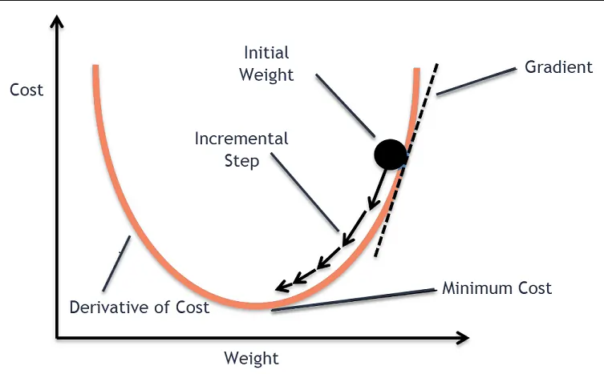
Visual explanation (CRITICAL DIAGRAM)
Diagram: Gradient descent moving toward minimum
Explanation:Ball rolls downhill toward minimum.
Each step reduces loss.
Practical example
Suppose loss function: 𝐿(𝑤)=(𝑤−5)^2
Goal: find w that minimizes loss.
Gradient: 𝑑𝐿/𝑑𝑤=2(𝑤−5)
Gradient descent adjusts w until w = 5.
Types of GradientDescent
Batch Gradient Descent: Uses entire dataset
Stochastic Gradient Descent (SGD): Uses one data point at a time
Mini-batch Gradient Descent: Uses small batch of data
Mini-batch is most commonly used.

Slide 131
Advantages
Works for large problems
Guaranteed convergence for convex functions
Foundation of deep learning
Disadvantages
May get stuck in local minima
Slow convergence sometimes
Requires learning rate tuning
When to use
Training ML models
Neural networks
Regression
Classification
Deep learning

Slide 132
When NOT to use
When analytical solution exists (rare)
Technical deep explanation
Gradient is vector of partial derivatives: ∇𝐿=(∂𝐿/∂𝑤1,∂𝐿/∂𝑤2,...)
Update rule:𝑤=𝑤−𝛼∇𝐿
This moves parameters toward minimum loss.
Convergence concept
Gradient descent repeats until: ∂𝐿/∂𝑤≈0
This means minimum reached.
Key intuition summary
Gradient = direction of steepest increase
Negative gradient = direction of steepest decrease
Gradient descent moves toward minimum loss.
Summary
Gradient descent minimizes loss function step-by-step.
It is the foundation of ML and Deep Learning optimization.

Slide 133
TOPIC 35: Learning Rate
Learning rate is one of the most critical hyperparameters in machine learning optimization.
It directly controls how fast or slow the model learns.
Definition
Learning Rate is a hyperparameter that determines how big a step the model takes while updating parameters during gradient descent.
In simple words: Learning rate controls how fast the model learns.
Why this concept existsGradient descent updates parameters step-by-step.
Learning rate controls step size.
If step size is too big → model may overshoot minimum.
If step size is too small → learning becomes very slow.

Slide 134
Real-life analogy
Imagine walking downhill.
Large steps → may miss lowest point.
Small steps → slow but precise.
Learning rate controls step size.
Mathematical Formula
Gradient descent update rule:𝑤=𝑤−𝛼∇𝐿
Explanation of symbols
w = model parameter
α (alpha) = learning rate
∇L = gradient
Learning rate multiplies gradient.
Controls update size.

Slide 135
Explanation:
Small learning rate → slow convergence
Optimal learning rate → fast convergence
Large learning rate → overshooting
Practical example
Suppose gradient = 10
Learning rate = 0.1
Update:𝑤=𝑤−1
Learning rate = 0.001
Update:𝑤=𝑤−0.01
Smaller update.
Types
Constant learning rate
Adaptive learning rate
Examples:Adam optimizer, RMSProp

Slide 136
Advantages of proper learning rate
Faster training
Better convergence
Stable learning
Disadvantages of improper learning rate
Too large → divergence
Too small → slow learning
When to use
Always used in gradient descent
When NOT to use
Cannot avoid learning rate in gradient descent

Slide 137
Technical deep explanation
Learning rate determines convergence speed:
If α too large: 𝐿𝑜𝑠𝑠→𝑖𝑛𝑐𝑟𝑒𝑎𝑠𝑒
If α optimal:𝐿𝑜𝑠𝑠→𝑚𝑖𝑛𝑖𝑚𝑢𝑚
Summary
Learning rate controls step size in optimization.

Slide 138
TOPIC 36: Convergence
Convergence determines when training stops.
Definition
Convergence occurs when the loss function stops decreasing and reaches minimum value.
In simple words: Model has finished learning.
Why this concept exists
Gradient descent updates parameters repeatedly.
Eventually, updates become very small.
Model reaches optimal point.
Real-life analogy
Ball rolling downhill eventually stops at lowest point.
This is convergence.

Slide 139
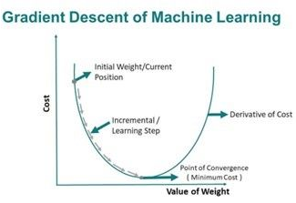
Mathematical Condition
Convergence condition:∇𝐿≈0
Explanation
∇L = gradient
Gradient near zero means minimum reached.
Visual explanation
Diagram: gradient descent convergence
Practical example
Loss values: 100, 50, 20, 5, 1, 0.9, 0.89, 0.889
Changes become very small → convergence.

Slide 140
Types
Fast convergence
Slow convergence
No convergence
Advantages
Ensures optimal solution
Stable training
Disadvantages
May converge to wrong minimum
When to use
Always monitored in training

Slide 141
When NOT to use
Cannot avoid convergence in optimization
Technical deep explanation
Convergence occurs when:∂𝐿/∂𝑤→0
Parameter updates stop changing.
Summary
Convergence means training has reached minimum loss.

Slide 142
TOPIC 37: Local Minima
Local minima is one of the main challenges in machine learning optimization, especially in deep learning.
Definition
A Local Minimum is a point where the loss function is lower than nearby points, but not the lowest possible point overall.
In simple words: It is a small valley, but not the deepest valley.
Why this concept exists
Loss functions in complex models are not smooth bowls.
They have many valleys.Gradient descent may stop at a smaller valley instead of the deepest valley.
This prevents the model from finding the best solution.
Real-life analogy
Imagine hiking in mountains.
You go downhill and reach a valley.
You stop there.
But there may be a deeper valley elsewhere.
This is local minima.

Slide 143
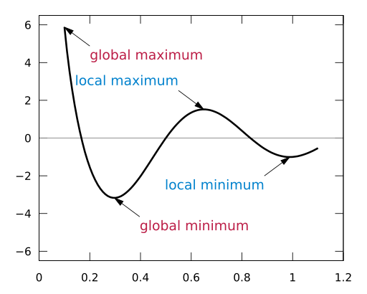
Mathematical Condition
Local minimum condition:∇𝐿=0
But: 𝐿𝑙𝑜𝑐𝑎𝑙>𝐿𝑔𝑙𝑜𝑏𝑎𝑙
Explanation of symbols
∇L = gradient
Gradient = 0 means minimum point
But loss at local minimum is higher than global minimum.
Visual explanation (VERY IMPORTANT DIAGRAM)
Diagram: Local vs Global minima
Practical example
Neural network loss function has many local minima.
Gradient descent may stop early.
Types
Multiple local minima
Flat local minima
Sharp local minima

Slide 144
Advantages
Some local minima still provide good performance
Disadvantages
May prevent optimal performance
Suboptimal solution
When local minima occurs
Deep learning
Non-convex loss functions
Complex models
When NOT to occur
Convex functions do not have local minima.
Example: Linear regression loss function

Slide 145
Slide 14: Technical deep explanation
Local minimum satisfies:∂𝐿/∂𝑤=0
But second derivative test shows: Not lowest possible value globally.
Summary
Local minimum is a suboptimal minimum point.
Gradient descent may get stuck here.

Slide 146
TOPIC 38: Global Minima
Global minima is the ultimate goal of machine learning optimization.
Definition
Global Minimum is the point where the loss function has the lowest possible value.
In simple words: It is the deepest valley.
Best possible solution.
Why this concept exists
Machine learning tries to minimize loss function.
Global minimum gives:
Best model parameters
Best predictions
Lowest possible error

Slide 147
Real-life analogy
Imagine the deepest point in entire mountain range.
This is global minimum.
Mathematical Condition
Global minimum satisfies: 𝐿(𝑤∗)≤𝐿(𝑤) for all w
Explanation of symbols
w* = optimal parameter
L(w*) = lowest loss
All other values have higher loss.
Practical example
Linear regression loss function has global minimum.
Gradient descent always finds optimal solution.
Types
Unique global minimum
Multiple global minima

Slide 148
Advantages
Best possible model
Highest accuracy
Optimal solution
Disadvantages
Hard to find in complex models
When global minima exists
Convex loss functions
Linear regression
Logistic regression
When hard to find
Deep learning
Neural networks
Non-convex functions

Slide 149
Technical deep explanation
Convex functions guarantee global minimum.
Non-convex functions may have multiple minima.
Goal of optimization: min⁡𝐿(𝑤)
Summary
Global minimum gives best possible solution.
Goal of machine learning optimization.

Slide 150
TOPIC 39: Activation Function
Activation functions are the core building blocks of neural networks and deep learning. Without activation functions, neural networks would behave like simple linear regression.
Definition
An Activation Function is a mathematical function applied to the output of a neuron to determine whether it should be activated or not.
In simple words:Activation function decides whether a neuron should pass information forward.
Why this concept exists
Without activation functions, neural networks can only learn linear relationships.
But real-world problems are nonlinear.
Activation functions introduce nonlinearity, allowing neural networks to learn complex patterns.

Slide 151
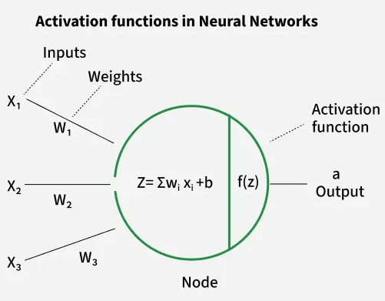
Real-life analogy
Human brain neurons activate only when signal strength crosses a threshold.
Similarly, activation function decides whether neuron activates.
Mathematical Formula
Neuron output: 𝑧=𝑤𝑥+𝑏
Activation output: 𝑎=𝑓(𝑧)
Explanation of symbols
x = input
w = weight
b = bias
z = linear combination
f(z) = activation function
a = final output
Visual explanation (CRITICAL DIAGRAM)
Diagram: neuron with activation functionImage
Explanation:Input → Weighted sum → Activation function → Output

Slide 152
Practical example
Without activation function:
Output always linear.
Cannot recognize complex patterns like images.
With activation function:
Neural network can detect faces, speech, objects.
Types of Activation Functions
Sigmoid
Tanh
ReLU
Leaky ReLU
Softmax
Advantages
Allows nonlinear learning
Enables deep learning
Improves model capability

Slide 153
Disadvantages
Some activation functions cause training problems
Example:Vanishing gradient problem
When to use
Neural networks
Deep learning
Classification
Computer vision
When NOT to use
Simple linear regression problems
Technical deep explanation
Without activation function: 𝑓(𝑥)=𝑙𝑖𝑛𝑒𝑎𝑟 𝑓𝑢𝑛𝑐𝑡𝑖𝑜𝑛
Stacking linear functions still produces linear function.
Activation functions introduce nonlinear transformation: 𝑓(𝑥)=𝑛𝑜𝑛𝑙𝑖𝑛𝑒𝑎𝑟
This enables learning of complex functions.
Summary
Activation functions introduce nonlinearity in neural networks.
They allow neural networks to learn complex real-world patterns.

Slide 154
TOPIC 40: Sigmoid Activation Function
Sigmoid is one of the most important and historically significant activation functions. It is widely used in logistic regression, binary classification, and neural networks.
Definition
The Sigmoid function is an activation function that converts any input value into a number between 0 and 1.
In simple words: Sigmoid converts output into probability.
Why this concept exists
In classification problems, we need probability outputs.
Example: Spam probability = 0.9
Sigmoid ensures output always lies between 0 and 1.
This makes it perfect for binary classification.

Slide 155
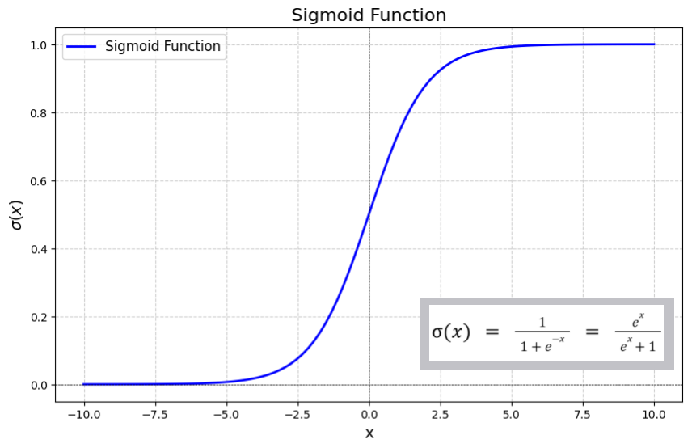
Real-life analogy
Imagine exam probability:
0 → definitely fail
1 → definitely pass
Sigmoid converts raw score into probability.
Mathematical Formula
Sigmoid function formula:𝜎(𝑥)=1/1+𝑒^−𝑥
Explanation of symbols
σ(x) = sigmoid output
x = input
e = Euler’s number (≈ 2.718)
Output range:0<𝜎(𝑥)<1
Visual explanation
Diagram: Sigmoid curve
Explanation: S-shaped curve
Negative input → output near 0
Positive input → output near 1

Slide 156
Practical example
Input: x = 0
Output: 𝜎(0)=1/2=0.5
Input: x = 5
Output: 𝜎(5)≈0.993
High probability.
Properties
Output range: (0,1)
Nonlinear function
Smooth and differentiable
Advantages
Produces probability output
Smooth gradient
Useful for binary classification

Slide 157
Disadvantages
Vanishing gradient problem
Slow training
Output not centered at zero
When to use
Binary classification
Logistic regression
Output layer of binary neural network
When NOT to use
Hidden layers of deep neural networks
ReLU works better there.

Slide 158
Technical deep explanation
Derivative of sigmoid:𝜎′(𝑥)=𝜎(𝑥)(1−𝜎(𝑥))
This makes gradient computation easy.
However, when x is very large or small: Gradient becomes very small.
This causes vanishing gradient problem.
Summary
Sigmoid converts input into probability between 0 and 1.
Widely used in binary classification.

Slide 159
TOPIC 41: Tanh Activation Function
Tanh (Hyperbolic Tangent) is an improved version of the sigmoid function. It is widely used in neural networks because it solves some major problems of sigmoid.
Definition
The Tanh function is an activation function that converts input values into outputs between −1 and +1.
In simple words: Tanh outputs values between negative and positive range.
Why this concept exists
Sigmoid outputs values between 0 and 1.
This creates bias because outputs are always positive.
Tanh solves this by producing outputs centered around zero.
This improves neural network training.

Slide 160
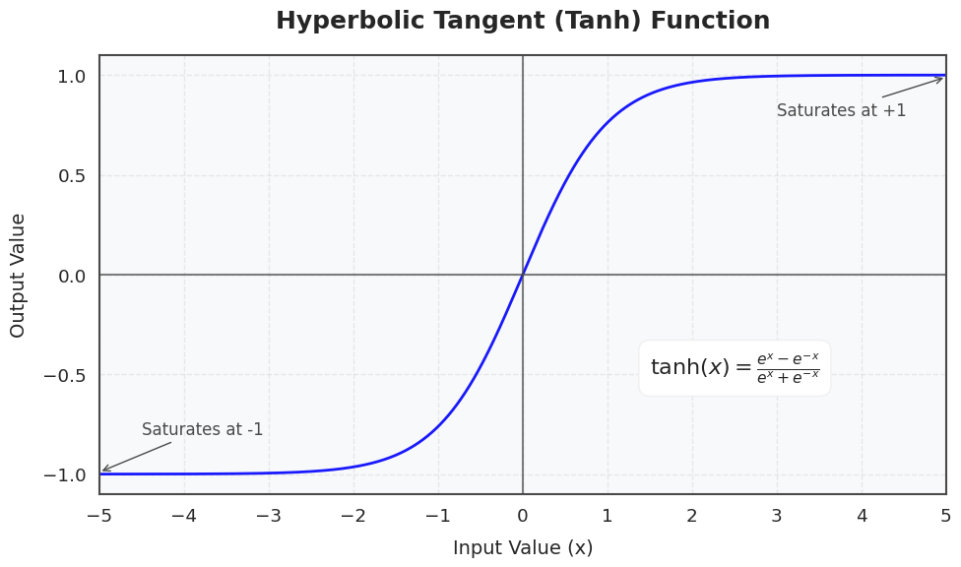
Real-life analogy
Think of temperature scale: Cold = negative, Neutral = zero, Hot = positive
Tanh works the same way.
Mathematical Formula
Tanh function formula: tanh⁡(𝑥)=𝑒^𝑥−𝑒^−𝑥/𝑒^𝑥+𝑒^−𝑥
Explanation of symbols
tanh(x) = output
x = input
e = Euler’s number (≈ 2.718)
Output range: −1<𝑡𝑎𝑛ℎ(𝑥)<1
Slide 7: Visual explanation
Diagram: Tanh curve
Explanation: S-shaped curve
Centered at zero
Negative input → negative output
Positive input → positive output

Slide 161
Practical example
Input: x = 0
Output: 𝑡𝑎𝑛ℎ(0)=0
Input: x = 3
Output: 𝑡𝑎𝑛ℎ(3)≈0.995
Input: x = -3
Output: 𝑡𝑎𝑛ℎ(−3)≈−0.995
Properties
Output range: (-1, 1)
Zero-centered
Nonlinear
Smooth and differentiable
Advantages
Zero-centered output
Faster training than sigmoid
Better gradient flow

Slide 162
Disadvantages
Still suffers from vanishing gradient problem
Computationally expensive compared to ReLU
When to use
Hidden layers in neural networks
When negative output needed
Recurrent neural networks (RNN)
When NOT to use
Very deep neural networks
ReLU performs better there.
Technical deep explanation
Derivative of tanh:𝑑/𝑑𝑥*𝑡𝑎𝑛ℎ(𝑥)=1−𝑡𝑎𝑛ℎ^2(𝑥)
Derivative is larger than sigmoid derivative.
This improves gradient flow.
However, for very large inputs, gradient still becomes small.
Summary
Tanh outputs values between −1 and +1.
Better than sigmoid but still has vanishing gradient problem.

Slide 163
TOPIC 42: ReLU (Rectified Linear Unit) Activation Function
ReLU is the most important and most widely used activation function in modern deep learning. It solved major problems that sigmoid and tanh could not.
Definition
ReLU is an activation function that outputs the input directly if it is positive, and outputs zero if it is negative.
In simple words: Negative input → output 0
Positive input → output same value
Why this concept exists
Sigmoid and Tanh suffer from vanishing gradient problem.
This slows down or stops learning in deep neural networks.
ReLU solves this by maintaining strong gradients for positive inputs.
This makes training faster and more efficient.

Slide 164
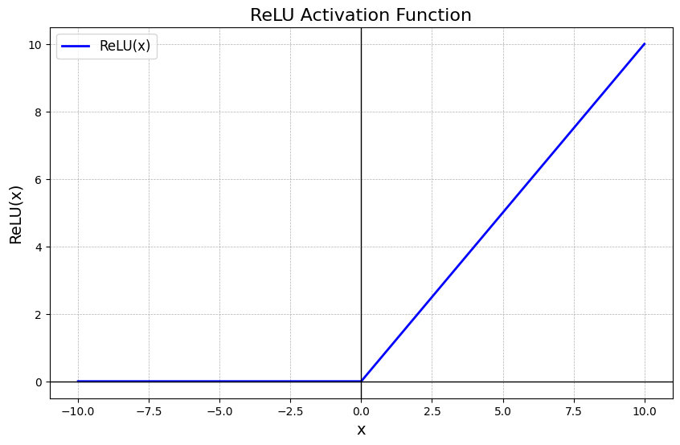
Real-life analogy
Think of a gate that only allows positive signals to pass.
Negative signals are blocked.
ReLU works like this gate.
Mathematical Formula
ReLU function: 𝑓(𝑥)=max⁡(0,𝑥)
Explanation of symbols
f(x) = output
x = input
If x ≥ 0 → f(x) = x
If x < 0 → f(x) = 0
Visual explanation
Diagram: ReLU function graph
Explanation:Negative side → flat at 0Positive side → straight line

Slide 165
Practical example
Input: x = -5
Output: f(x) = 0
Input:x = 3
Output: f(x) = 3
Properties
Output range: [0, ∞)
Nonlinear
Computationally simple
Fast computation
Advantages
Very fast training
Solves vanishing gradient problem
Simple computation
Efficient for deep networks
Disadvantages
Dying ReLU problem
Some neurons may permanently output zero

Slide 166
When to use
Hidden layers in deep neural networks
Computer vision
Deep learning
Most neural networks use ReLU
When NOT to use
Output layer of classification problems
Use Softmax or Sigmoid instead.
Technical deep explanation
Derivative of ReLU:𝑓′(𝑥)=1 𝑥>0, 0 𝑥<0
​This ensures strong gradient for positive inputs.
This makes training efficient.
Why ReLU is better than Sigmoid and Tanh
Sigmoid gradient → very small
Tanh gradient → small
ReLU gradient → strong and stable
This makes deep learning possible.
Summary
ReLU is the most important activation function in deep learning.
It enables fast and efficient neural network training.

Slide 167
TOPIC 43: Leaky ReLU Activation Function
Leaky ReLU is an improved version of ReLU designed to solve one of ReLU’s biggest problems: the Dying ReLU problem.
Definition
Leaky ReLU is an activation function that allows a small, non-zero output for negative inputs instead of outputting zero like ReLU.
In simple words: Negative input → small negative output, Positive input → normal positive output
Why this concept exists
ReLU outputs zero for all negative inputs.
This can cause neurons to stop learning permanently.
This is called the Dying ReLU problem.
Leaky ReLU solves this by allowing a small gradient for negative inputs.
This keeps neurons alive and learning.

Slide 168
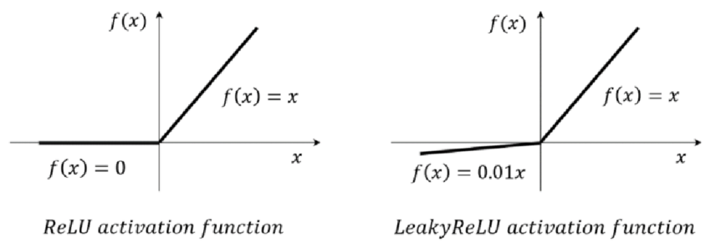
Real-life analogy
Think of a gate that:
Fully opens for positive signals
Partially opens for negative signals
Instead of completely blocking negative signals.
Mathematical Formula
Leaky ReLU function:𝑓(𝑥)=𝑥 𝑥>0, 𝛼𝑥 𝑥≤0 ​
Explanation of symbols
f(x) = output
x = input
α (alpha) = small constant (usually 0.01)
Example: If x = -10
Output:𝑓(𝑥)=−0.1
Visual explanation
Diagram: ReLU vs Leaky ReLU
Explanation:
ReLU negative side = flat line
Leaky ReLU negative side = small slope

Slide 169
Practical example
Input:x = -5
ReLU output: 0
Leaky ReLU output: −0.05
Input:x = 5
Output: 5
Properties
Output range: (-∞, ∞)
Nonlinear
Allows small negative output
Advantages
Solves dying ReLU problem
Better gradient flow
Improves deep network training

Slide 170
Disadvantages
Slightly more complex than ReLU
Requires choosing alpha value
When to use
Deep neural networks
When dying ReLU problem occurs
Computer vision
Deep learning
When NOT to use
Simple neural networks
When ReLU already works well
Technical deep explanation
Derivative of Leaky ReLU: 𝑓′(𝑥)={1 𝑥>0, 𝛼 𝑥≤0
​Unlike ReLU, gradient never becomes zero completely.
This allows continuous learning.
Summary
Leaky ReLU solves dying ReLU problem.
Improves neural network training.

Slide 171
TOPIC 44: Softmax Activation Function
Softmax is the most important activation function for multiclass classification problems. It converts outputs into probabilities that sum to 1.
Definition
Softmax is an activation function that converts multiple input values into probabilities that sum to 1.
In simple words: Softmax tells the probability of each class.
Why this concept exists
In multiclass classification, we need probability for each class.
Example: Cat = 0.7, Dog = 0.2, Bird = 0.1, Total = 1
Softmax provides this probability distribution.
Real-life analogy
Suppose you predict weather: Sunny: 70%, Rainy: 20%, Cloudy: 10%
Softmax converts raw scores into probabilities.

Slide 172
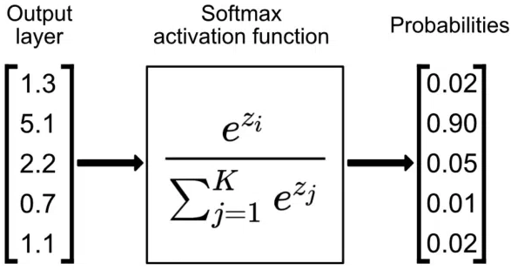
Mathematical Formula
Softmax function: 𝑆𝑜𝑓𝑡𝑚𝑎𝑥(𝑥𝑖)=𝑒^𝑥𝑖/∑𝑗=1𝑛*𝑒^𝑥𝑗
Explanation of symbols
xᵢ = input value
e = Euler’s number (≈ 2.718)
n = total number of classes
Denominator ensures sum of probabilities = 1
Visual explanation
Diagram: Softmax probability distribution
Explanation: Raw scores converted into probability distribution.
Practical example
Input scores: Cat = 2, Dog = 1, Bird = 0
Softmax output: Cat = 0.67, Dog = 0.24, Bird = 0.09, Sum = 1

Slide 173
Properties
Output range: (0,1)
Sum of outputs = 1
Produces probability distribution
Advantages
Provides probability for each class
Perfect for multiclass classification
Works well with cross entropy loss
Disadvantages
Computationally expensive
Sensitive to large input values
When to use
Output layer of neural networks
Multiclass classification
Deep learning
Image classification

Slide 174
When NOT to use
Binary classification
Use sigmoid instead.
Technical deep explanation
Softmax converts logits into probability distribution.
Used with cross entropy loss: 𝐿𝑜𝑠𝑠=−∑𝑦𝑖log⁡(𝑦 𝑖 ^)
This enables proper multiclass learning.
Summary
Softmax converts outputs into probability distribution.
Essential for multiclass classification.

Slide 175
TOPIC 45: Confusion Matrix (FOUNDATION OF ALL EVALUATION METRICS)
Confusion Matrix is the most important concept in evaluation metrics. All other metrics (Accuracy, Precision, Recall, F1) come from it.
Definition
A Confusion Matrix is a table used to evaluate classification models by comparing actual values with predicted values.
In simple words: It shows correct and incorrect predictions.
Why this concept exists
Accuracy alone is not enough.
We need detailed information:
• How many positives predicted correctly
• How many negatives predicted correctly
• What mistakes were made
Confusion matrix provides complete breakdown.

Slide 176
Real-life analogy
Medical test example: Actual → Sick or Healthy, Predicted → Sick or Healthy
Confusion matrix shows:
Correct diagnosis
Wrong diagnosis
Confusion Matrix Structure
𝑃𝑟𝑒𝑑𝑖𝑐𝑡𝑒𝑑 𝑃𝑜𝑠𝑖𝑡𝑖𝑣𝑒 𝑃𝑟𝑒𝑑𝑖𝑐𝑡𝑒𝑑 𝑁𝑒𝑔𝑎𝑡𝑖𝑣𝑒
𝐴𝑐𝑡𝑢𝑎𝑙 𝑃𝑜𝑠𝑖𝑡𝑖𝑣𝑒 𝑇𝑃 𝐹𝑁
𝐴𝑐𝑡𝑢𝑎𝑙 𝑁𝑒𝑔𝑎𝑡𝑖𝑣𝑒 𝐹𝑃 𝑇𝑁
Explanation of each term (CRITICAL)
True Positive (TP)
Model predicts positive and actual is positive
Correct prediction
Example: Sick person predicted sick
True Negative (TN)
Model predicts negative and actual is negative
Correct prediction
Example: Healthy person predicted healthy

Slide 177
False Positive (FP)
Model predicts positive but actual is negative
Wrong prediction
Example: Healthy person predicted sick
Also called: Type I Error
False Negative (FN)
Model predicts negative but actual is positive
Wrong prediction
Example: Sick person predicted healthy
Also called: Type II Error
Practical example
Suppose: TP = 40, TN = 50, FP = 5, FN = 5, Total = 100
This matrix will be used to calculate all metrics.
Types of confusion matrix
Binary confusion matrix (2 classes)
Multiclass confusion matrix (multiple classes)

Slide 178
Advantages
Provides full performance breakdown
Foundation of all evaluation metrics
Disadvantages
Cannot directly give single performance number
When to use
Always used in classification problems
When NOT to use
Regression problems
Technical deep explanation
Confusion matrix defines joint distribution: 𝑃(𝑎𝑐𝑡𝑢𝑎𝑙,𝑝𝑟𝑒𝑑𝑖𝑐𝑡𝑒𝑑)
Used to derive all evaluation metrics.
Summary
Confusion matrix is the foundation of all classification metrics.

Slide 179
TOPIC 46: Accuracy
Accuracy is the most basic and widely used evaluation metric in machine learning.
Definition
Accuracy measures the percentage of correct predictions made by the model.
In simple words: Accuracy tells how often the model is correct.
Why this concept exists
Machine learning models make predictions.
We need a way to measure how good the predictions are.
Accuracy provides a simple performance measure.
Real-life analogy
Suppose student answers 100 questions.
Correct answers = 90
Accuracy = 90%

Slide 180
Mathematical Formula
𝐴𝑐𝑐𝑢𝑟𝑎𝑐𝑦=𝐶𝑜𝑟𝑟𝑒𝑐𝑡 𝑃𝑟𝑒𝑑𝑖𝑐𝑡𝑖𝑜𝑛𝑠/𝑇𝑜𝑡𝑎𝑙 𝑃𝑟𝑒𝑑𝑖𝑐𝑡𝑖𝑜𝑛𝑠
Expanded Formula (Using Confusion Matrix)
𝐴𝑐𝑐𝑢𝑟𝑎𝑐𝑦=𝑇𝑃+𝑇𝑁/𝑇𝑃+𝑇𝑁+𝐹𝑃+𝐹𝑁
Explanation of symbols
TP = True Positive, Correct positive prediction
TN = True Negative, Correct negative prediction
FP = False Positive, Wrong positive prediction
FN = False Negative, Wrong negative prediction
Practical example
Total predictions = 100
Correct predictions = 90
Accuracy:𝐴𝑐𝑐𝑢𝑟𝑎𝑐𝑦=90/100=90%
Advantages
Simple to understand
Easy to calculate
Works well for balanced datasets

Slide 181
Disadvantages
Misleading for imbalanced datasets
Example: If 95% data is negative, model predicting always negative gives 95% accuracy but is useless.
When to use
Balanced datasets
General model evaluation
When NOT to use
Imbalanced datasets
Example: Fraud detection, Disease detection
Use precision and recall instead.
Technical deep explanation
Accuracy measures overall correctness: 𝐴𝑐𝑐𝑢𝑟𝑎𝑐𝑦=𝑃(𝑦^=𝑦)
But does not measure type of errors.
Summary
Accuracy measures percentage of correct predictions.
Not reliable for imbalanced datasets.

Slide 182
TOPIC 47: Precision
Precision is critical when False Positives are dangerous.
Definition
Precision measures how many predicted positives are actually correct.
In simple words: Precision answers: "When model predicts positive, how often is it correct?“
Why this concept exists
Accuracy does not differentiate error types.
Precision focuses on positive prediction correctness.
Real-life analogy
Spam detection: Model predicts 100 emails as spam
Actually spam = 80
Precision = 80%

Slide 183
Mathematical Formula
𝑃𝑟𝑒𝑐𝑖𝑠𝑖𝑜𝑛=𝑇𝑃/𝑇𝑃+𝐹𝑃
Explanation of symbols
TP = True Positive
FP = False Positive
Precision measures prediction correctness.
Practical example
TP = 40
FP = 10
𝑃𝑟𝑒𝑐𝑖𝑠𝑖𝑜𝑛=40/50=80%
Range
0≤𝑃𝑟𝑒𝑐𝑖𝑠𝑖𝑜𝑛≤1
Higher precision = better model
Advantages
Measures positive prediction accuracy
Important when false positives are costly

Slide 184
Disadvantages
Ignores false negatives
When to use
Spam detection
Fraud detection
Search engines
When NOT to use
When false negatives are critical
Technical deep explanation
Precision measures conditional probability: 𝑃(𝑎𝑐𝑡𝑢𝑎𝑙 𝑝𝑜𝑠𝑖𝑡𝑖𝑣𝑒∣𝑝𝑟𝑒𝑑𝑖𝑐𝑡𝑒𝑑 𝑝𝑜𝑠𝑖𝑡𝑖𝑣𝑒)
Summary
Precision measures correctness of positive predictions.

Slide 185
TOPIC 48: Recall (Sensitivity / True Positive Rate)
Recall is one of the most critical evaluation metrics, especially in medical diagnosis, fraud detection, and safety-critical systems.
Definition
Recall measures how many actual positive cases were correctly identified by the model.
In simple words: Recall answers: "Out of all real positives, how many did the model detect?“
Why this concept exists
Some problems require detecting ALL positive cases.
Missing positive cases can be dangerous.
Example: Cancer detection
Missing cancer patient = dangerous
Recall helps measure detection ability.
Real-life analogy
Suppose:100 people have cancer
Model detects 90
Recall = 90%
10 people missed → dangerous

Slide 186
Mathematical Formula
𝑅𝑒𝑐𝑎𝑙𝑙=𝑇𝑃/𝑇𝑃+𝐹𝑁
Explanation of symbols
TP = True Positive, Correctly predicted positive
FN = False Negative, Missed positive
TP + FN = total actual positives
Recall measures detection ability.
Practical example
Suppose: Actual cancer patients = 100
Model detects = 90
Missed = 10
𝑅𝑒𝑐𝑎𝑙𝑙=90/100=0.9=90%
Range and interpretation
0≤𝑅𝑒𝑐𝑎𝑙𝑙≤1
Recall = 1 → perfect detection
Recall = 0 → detects nothing
Higher recall = better detection

Slide 187
Advantages
Detects most positive cases
Critical for safety systems
Useful in medical diagnosis
Disadvantages
May increase false positives
High recall does not guarantee accuracy
Example: Predict everything as positive → Recall = 100%
But useless model.
When to use (VERY IMPORTANT)
Use when False Negatives are dangerous: Medical diagnosis, Fraud detection, Security systems, Disease detection
Example: Missing fraud = dangerous
When NOT to use
When false positives are more dangerous
Example: Spam detection (precision more important)

Slide 188
Slide 14: Technical deep explanation (Probability interpretation)
Recall measures conditional probability:𝑅𝑒𝑐𝑎𝑙𝑙=𝑃(𝑃𝑟𝑒𝑑𝑖𝑐𝑡𝑒𝑑 𝑃𝑜𝑠𝑖𝑡𝑖𝑣𝑒∣𝐴𝑐𝑡𝑢𝑎𝑙 𝑃𝑜𝑠𝑖𝑡𝑖𝑣𝑒)
This means: Probability model detects positive when positive exists.
Also called: True Positive Rate (TPR)
Used in ROC curve.
Threshold effect on Recall
Classification uses threshold: Default threshold = 0.5
Lower threshold → Higher recall
Higher threshold → Lower recall
Example: Threshold = 0.2 → model detects more positives → recall increases
Summary
Recall measures model’s ability to detect positive cases.
Critical in medical, fraud, and safety systems.

Slide 189
TOPIC 49: F1 Score (Balanced Metric)
F1 Score is one of the most important metrics when dealing with imbalanced datasets.
Definition
F1 Score is the harmonic mean of Precision and Recall.
In simple words: F1 Score balances Precision and Recall.
Why this concept exists
Precision alone is not enough
Recall alone is not enough
We need balance between both.
F1 Score provides balanced evaluation.
Slide 4: Real-life analogy
Suppose:
Precision = 100%
Recall = 0%
Model useless.
F1 score reflects this problem.

Slide 190
Mathematical Formula
𝐹1=2×𝑃𝑟𝑒𝑐𝑖𝑠𝑖𝑜𝑛×𝑅𝑒𝑐𝑎𝑙𝑙/𝑃𝑟𝑒𝑐𝑖𝑠𝑖𝑜𝑛+𝑅𝑒𝑐𝑎𝑙𝑙
Alternative formula using confusion matrix
𝐹1=2𝑇𝑃/2𝑇𝑃+𝐹𝑃+𝐹𝑁 ​
Explanation of symbols
TP = True Positive
FP = False Positive
FN = False Negative
F1 balances both error types.
Slide 8: Why harmonic mean is used (CRITICAL)
Harmonic mean punishes imbalance.
Example: Precision = 1, Recall = 0, F1 = 0
Arithmetic mean would give misleading result.
Practical example
Precision = 0.8
Recall = 0.6
𝐹1=2×0.8×0.6/0.8+0.6=0.685

Slide 191
Range and interpretation
0≤𝐹1≤1
F1 = 1 → perfect model
F1 = 0 → worst model
Higher F1 = better balanced performance
Advantages
Best metric for imbalanced datasets
Balances precision and recall
Widely used in ML competitions
Disadvantages
Does not include true negatives
May hide individual precision and recall performance

Slide 192
When to use (VERY IMPORTANT)
Imbalanced datasets
Fraud detection
Medical diagnosis
Search engines
NLP classification
When NOT to use
When true negatives important
Example: General accuracy problems
Technical deep explanation
F1 Score minimizes both error types: False positives, False negatives
Used in optimization: max⁡𝐹1
Summary
F1 Score balances precision and recall.
Best metric for imbalanced datasets.

Slide 193
TOPIC 50: Specificity (True Negative Rate)
Specificity is the opposite of Recall. It measures how well the model detects negatives.
Definition
Specificity measures how many actual negative cases were correctly identified.
In simple words: Specificity answers: "Out of all real negatives, how many did the model correctly detect?“
Why this concept exists
In some problems, detecting negatives correctly is important.
Example: Fraud detection
Wrongly marking legitimate transaction as fraud is bad.
Specificity measures this ability.
Real-life analogy
Suppose:100 healthy people
Model correctly identifies 90 healthy
Specificity = 90%

Slide 194
Mathematical Formula
𝑆𝑝𝑒𝑐𝑖𝑓𝑖𝑐𝑖𝑡𝑦=𝑇𝑁/𝑇𝑁+𝐹𝑃
Explanation of symbols
TN = True Negative
FP = False Positive
TN + FP = total actual negatives
Practical example
TN = 90
FP = 10
𝑆𝑝𝑒𝑐𝑖𝑓𝑖𝑐𝑖𝑡𝑦=90/100=90%
Range
0≤𝑆𝑝𝑒𝑐𝑖𝑓𝑖𝑐𝑖𝑡𝑦≤1
Higher specificity = better negative detection

Slide 195
Advantages
Measures negative detection ability
Important in fraud detection
Disadvantages
Does not measure positive detection
When to use
Fraud detection
Spam filtering
Security systems
When NOT to use
When positive detection more important
Technical deep explanation
Specificity measures:𝑃(𝑃𝑟𝑒𝑑𝑖𝑐𝑡𝑒𝑑 𝑁𝑒𝑔𝑎𝑡𝑖𝑣𝑒∣𝐴𝑐𝑡𝑢𝑎𝑙 𝑁𝑒𝑔𝑎𝑡𝑖𝑣𝑒)
Also called True Negative Rate (TNR)
Summary
Specificity measures how well model detects negatives.

Slide 196
TOPIC 51: False Positive Rate (FPR)
FPR is critical for understanding false alarms made by the model.
Definition
False Positive Rate measures how many actual negative cases were incorrectly predicted as positive.
In simple words: FPR answers: "Out of all real negatives, how many were falsely predicted as positive?“
Why this concept exists
False positives can be dangerous or costly.
Examples:
Fraud detection → legitimate transaction blocked
Medical test → healthy person diagnosed sick
FPR measures false alarm rate.
Real-life analogy
Airport security scanner: 100 safe passengers
Scanner wrongly flags 5
FPR = 5%

Slide 197
Mathematical Formula
𝐹𝑃𝑅=𝐹𝑃/𝐹𝑃+𝑇𝑁
Explanation of symbols
FP = False Positive
TN = True Negative
FP + TN = total actual negatives
FPR = proportion of false alarms
Practical example
Suppose:
FP = 20
TN = 180
𝐹𝑃𝑅=20/200=0.1=10%
Range and interpretation
0≤𝐹𝑃𝑅≤1
FPR = 0 → perfect model
FPR = 1 → worst model
Lower FPR = better
Relationship with Specificity
𝐹𝑃𝑅=1−𝑆𝑝𝑒𝑐𝑖𝑓𝑖𝑐𝑖𝑡𝑦
Specificity = TN/(TN+FP)

Slide 198
Advantages
Measures false alarm rate
Important for safety systems
Disadvantages
Does not measure detection ability
Need recall also.
When to use
Fraud detection
Medical testing
Security systems
Technical deep explanation (Probability interpretation)
FPR measures conditional probability: 𝐹𝑃𝑅=𝑃(𝑃𝑟𝑒𝑑𝑖𝑐𝑡𝑒𝑑 𝑃𝑜𝑠𝑖𝑡𝑖𝑣𝑒∣𝐴𝑐𝑡𝑢𝑎𝑙 𝑁𝑒𝑔𝑎𝑡𝑖𝑣𝑒)
This measures incorrect positive prediction probability.
Summary
FPR measures false alarm rate.
Lower FPR means better model.

Slide 199
TOPIC 52: ROC Curve (Receiver Operating Characteristic Curve)
ROC curve is one of the most important tools in classification evaluation.
Definition
ROC curve is a graph showing model performance across different classification thresholds.
It plots: True Positive Rate vs False Positive Rate
Why this concept exists
Classification models output probabilities.
Different thresholds produce different results.
ROC curve shows performance across ALL thresholds.
Real-life analogy
Suppose cancer detection threshold:
Threshold = 0.5 → moderate detection
Threshold = 0.2 → detects more cancer
Threshold = 0.8 → detects fewer cancer
ROC shows all possible threshold performance.

Slide 200
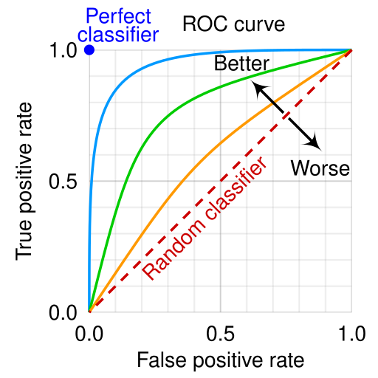
Mathematical Definition
ROC curve plots:
Y-axis:𝑇𝑃𝑅=𝑇𝑃/𝑇𝑃+𝐹𝑁 ​
X-axis:𝐹𝑃𝑅=𝐹𝑃/𝐹𝑃+𝑇𝑁
Explanation of symbols
TPR = Recall
FPR = False positive rate
Each threshold gives one point.
Curve connects all points.
Key interpretation points
Top-left corner = perfect model
Diagonal line = random model
Closer to top-left = better model
Threshold effect explanation
Threshold = 0 → everything positive
TPR = 1, FPR = 1
Threshold = 1 → everything negative
TPR = 0, FPR = 0
ROC curve connects these.

Slide 201
Advantages
Shows full model performance
Independent of threshold
Disadvantages
Hard to interpret numerically
Requires AUC score
When to use
Classification model evaluation
Model comparison
Medical diagnosis
When NOT to use
Regression problems
Technical deep explanation
ROC curve shows tradeoff: Increasing recall increases FPR.
Model performance evaluated across full probability distribution.
Summary
ROC curve shows performance at all thresholds.

Slide 202
TOPIC 53: AUC (Area Under ROC Curve)
AUC converts ROC curve into single number.
Definition
AUC measures the total area under ROC curve.
It represents overall classification performance.
Why this concept exists
ROC curve is graphical.
We need numerical score.
AUC provides this.
Real-life analogy
AUC measures overall ability of model to distinguish between positive and negative cases.
Mathematical Definition
𝐴𝑈𝐶=∫𝑇𝑃𝑅 𝑑(𝐹𝑃𝑅)
Explanation
Integral measures area under ROC curve.
Higher area = better performance.

Slide 203
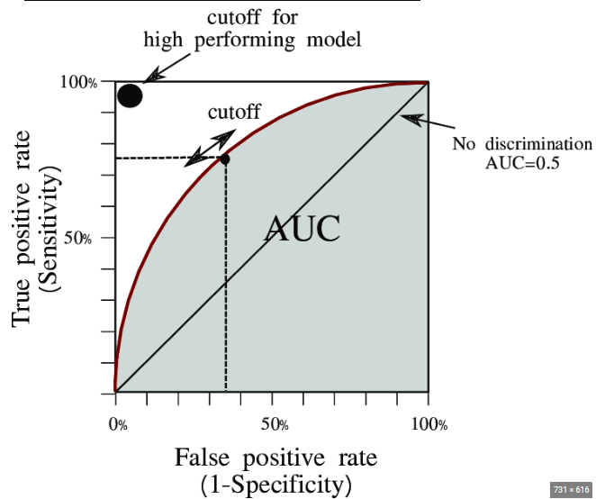
Range and interpretation
0≤𝐴𝑈𝐶≤1
Interpretation table
AUC Meaning
1.0 Perfect model
0.9–0.99 Excellent
0.8–0.89 Good
0.7–0.79 Fair
0.5–0.69 Poor
0.5 Random
Advantages
Single performance score
Threshold independent
Disadvantages
Does not show specific threshold performance
When to use
Model comparison
Binary classification

Slide 204
When NOT to use
Regression problems
Technical deep explanation (Probability interpretation)
AUC measures probability:𝑃(𝑀𝑜𝑑𝑒𝑙 𝑟𝑎𝑛𝑘𝑠 𝑝𝑜𝑠𝑖𝑡𝑖𝑣𝑒 ℎ𝑖𝑔ℎ𝑒𝑟 𝑡ℎ𝑎𝑛 𝑛𝑒𝑔𝑎𝑡𝑖𝑣𝑒)
This means model separates classes correctly.
Summary
AUC measures overall model performance.

Slide 205
TOPIC 54: Regularization
Regularization is a core technique used to improve model generalization and prevent overfitting.
Definition
Regularization is a technique used to prevent overfitting by adding a penalty to the model for being too complex.
In simple words: Regularization discourages the model from memorizing data.
Why this concept exists
Machine learning models can become too complex.
Complex models memorize training data → overfitting.
Regularization forces model to stay simple.
This improves performance on new data.
Real-life analogy
Imagine fitting a flexible wire through points.
Without restriction → wire bends too much (overfitting)
With restriction → smoother wire (better generalization)
Regularization acts like restriction.

Slide 206
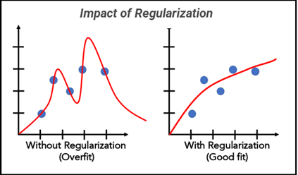
Mathematical Formula (General Form)
Regularized loss function: 𝐿𝑜𝑠𝑠=𝑂𝑟𝑖𝑔𝑖𝑛𝑎𝑙 𝐿𝑜𝑠𝑠+𝜆×𝑃𝑒𝑛𝑎𝑙𝑡𝑦
Explanation of symbols
Original Loss = error between prediction and actual value
λ (lambda) = regularization parameter
Penalty = complexity penalty
Higher λ → simpler model
Lower λ → complex model
Visual explanation (CRITICAL DIAGRAM)
Diagram: Regularization effect on regression
Explanation:
Without regularization → overfitting curve
With regularization → smoother curve
Practical example
Without regularization: Model fits noise.
With regularization: Model captures true pattern.
Better generalization.

Slide 207
Types of Regularization:
L1 Regularization → Lasso Regression
L2 Regularization → Ridge Regression
Elastic Net → combination of both
Advantages
Prevents overfitting
Improves generalization
Reduces model complexity
Improves stability
Disadvantages
May cause underfitting if too strong
Requires tuning λ parameter
When to use
Overfitting problems
High-dimensional data
Regression models
Neural networks
When NOT to use
Very simple models
Small feature sets

Slide 208
Technical deep explanation
Regularization modifies optimization problem: Original objective: min⁡𝐿𝑜𝑠𝑠
Regularized objective: min⁡(𝐿𝑜𝑠𝑠+𝜆𝑃𝑒𝑛𝑎𝑙𝑡𝑦)
Penalty discourages large weights.
Large weights cause overfitting.
Effect on weights
Without regularization: Weights can become very large.
With regularization: Weights become smaller.
Smaller weights = simpler model.
Relationship with Bias and Variance
Regularization increases bias slightly.
Regularization reduces variance significantly.
Overall effect: Better generalization.
Summary
Regularization prevents overfitting by penalizing complex models.
Improves performance on unseen data.

Slide 209
TOPIC 55: Ridge Regression (L2 Regularization)
Ridge Regression is one of the most important regularization techniques used to prevent overfitting in regression models.
Definition
Ridge Regression is a regression technique that adds a penalty equal to the square of the weights to the loss function.
In simple words: Ridge Regression reduces model complexity by shrinking weights.
Why this concept exists
Linear regression can overfit when:
• Too many features
• High feature correlation
• Noisy dataRidge Regression solves this by limiting weight size.
This prevents extreme weight values.

Slide 210
Real-life analogy
Imagine assigning importance to factors affecting house price:
Size → important
Color → less important
Ridge reduces importance of less useful features instead of removing them completely.
Mathematical Formula (Linear Regression Loss)
Original loss:𝐿𝑜𝑠𝑠=∑(𝑦−𝑦^)^2
Ridge Regression Formula
𝐿𝑜𝑠𝑠=∑(𝑦−𝑦^)^2+𝜆∑𝑤𝑖^2
Explanation of symbols
y = actual value
ŷ = predicted value
wᵢ = model weights
λ = regularization parameter
Second term is penalty.
Penalty increases when weights increase.

Slide 211
Practical example
Suppose weights:
Without Ridge: w₁ = 100, w₂ = 200
With Ridge: w₁ = 10, w₂ = 20
Weights shrink.
Effect on weights
Ridge regression: Reduces weight magnitude
Does NOT make weights zero
All features remain in model.
Advantages
Prevents overfitting
Works well with multicollinearity
Keeps all features
Stable solution

Slide 212
Disadvantages
Does not perform feature selection
All features remain even if irrelevant
When to use
Many correlated features
High dimensional data
Multicollinearity problems
When NOT to use
When feature selection required
Use Lasso instead.
Technical deep explanation
Ridge minimizes: min⁡(∑(𝑦−𝑦^)^2+𝜆∑𝑤^2)
Derivative:𝑤=(𝑋^𝑇*𝑋+𝜆𝐼)^−1*𝑋^𝑇*𝑦
This stabilizes matrix inversion.

Slide 213
Geometry interpretation
Ridge constraint creates circular constraint region.
Solution lies inside circle.
Prevents large weights.
Effect of lambda (CRITICAL)
λ = 0 → normal linear regression
λ large → very small weights
λ very large → underfitting
Summary
Ridge Regression reduces weight size but keeps all features.
Prevents overfitting and improves generalization.

Slide 214
TOPIC 56: Lasso Regression (L1 Regularization)
Lasso Regression is one of the most powerful regularization techniques because it not only prevents overfitting but also performs automatic feature selection.
Definition (Simple)
Lasso Regression is a regression technique that adds a penalty equal to the absolute value of the weights to the loss function.
In simple words: Lasso reduces weights and can completely remove unimportant features.
Why this concept existsIn many datasets, some features are useless.
Normal regression keeps all features.
Lasso Regression automatically removes useless features by making their weights zero.
This simplifies the model.

Slide 215
Real-life analogy
Imagine predicting salary using:
Experience → important
Height → not important
Lasso reduces weight of height to zero and removes it from model.
Mathematical Formula (Original Loss)
Linear regression loss: 𝐿𝑜𝑠𝑠=∑(𝑦−𝑦^)^2
Lasso Regression Formula: 𝐿𝑜𝑠𝑠=∑(𝑦−𝑦^)^2+𝜆∑∣𝑤𝑖∣
Explanation of symbols
y = actual value
ŷ = predicted value
wᵢ = model weights
λ = regularization parameter
|wᵢ| = absolute value of weights
Penalty encourages weights to become zero.

Slide 216
Practical example
Suppose model has weights:
Before Lasso: w₁ = 100, w₂ = 50, w₃ = 0.1
After Lasso: w₁ = 10, w₂ = 5, w₃ = 0
Feature 3 removed.
Effect on weights (CRITICAL)
Lasso can:
Reduce weights
Make weights exactly zero
This removes features automatically.
This is called feature selection.
Advantages
Prevents overfitting
Performs feature selection
Simplifies model
Improves interpretability

Slide 217
Disadvantages
May remove useful features accidentally
Unstable when features highly correlated
When to use
Feature selection required
High dimensional data
Sparse datasets
When NOT to use
Highly correlated features
Ridge works better there.
Technical deep explanation
Lasso minimizes: min⁡(∑(𝑦−𝑦^)^2+𝜆∑∣𝑤∣)
L1 penalty creates sparse solution.
Sparse means many weights become zero.

Slide 218
Geometry interpretation
Lasso constraint region is diamond-shaped.
Corners encourage weights to become zero.
This creates sparse model.
Effect of lambda
λ = 0 → normal regression
λ increases → more weights become zero
λ very large → underfitting
Ridge vs Lasso comparison (IMPORTANT)
Feature Ridge Lasso
Penalty w² |w|
Feature selection No Yes
Removes features No Yes
Best for Correlated features Sparse features
Summary
Lasso Regression performs regularization and feature selection.
It simplifies model by removing useless features.

Slide 219
TOPIC 57: Elastic Net Regularization
Elastic Net is one of the most powerful regularization techniques because it combines the strengths of both Ridge Regression (L2) and Lasso Regression (L1).
It solves their individual limitations.
Definition
Elastic Net is a regularization technique that combines both L1 penalty (Lasso) and L2 penalty (Ridge).
In simple words: Elastic Net both shrinks weights and removes useless features.
Why this concept exists
Ridge Regression problem: Does not remove features.
Lasso Regression problem: Unstable when features are highly correlated.
Elastic Net solves both problems by combining them.

Slide 220
Real-life analogy
Imagine managing employees:
Ridge → reduces salaries but keeps all employees
Lasso → fires some employees
Elastic Net → reduces salaries and fires unnecessary employees
Balanced approach.
Mathematical Formula (General Loss)
Original loss: 𝐿𝑜𝑠𝑠=∑(𝑦−𝑦^)^2
Elastic Net Formula𝐿𝑜𝑠𝑠=∑(𝑦−𝑦^)^2+𝜆1∑∣𝑤∣+𝜆^2∑𝑤^2
Alternative simplified formula𝐿𝑜𝑠𝑠=∑(𝑦−𝑦^)^2+𝜆(𝛼∑∣𝑤∣+(1−𝛼)∑𝑤^2)
Explanation of symbols
y = actual value
ŷ = predicted value
w = weights
λ = overall regularization strength
α = balance parameter
α = 1 → Lasso
α = 0 → Ridge
0 < α < 1 → Elastic Net

Slide 221
Practical example
Suppose weights:
Before regularization: w₁ = 100, w₂ = 50, w₃ = 10
After Elastic Net: w₁ = 20, w₂ = 5, w₃ = 0
Some weights reduced, some removed.
Advantages
Prevents overfitting
Performs feature selection
Handles correlated features well
More stable than Lasso
More flexible than Ridge
Disadvantages
Requires tuning two parameters (λ and α)
More complex than Ridge or Lasso

Slide 222
When to use
High dimensional datasets
Correlated features
Feature selection required
Best general-purpose regularization method
When NOT to use
Very simple datasets
Small datasets
Technical deep explanation
Elastic Net optimization problem: min⁡(𝐿𝑜𝑠𝑠+𝜆1∣∣𝑤∣∣1+𝜆2∣∣𝑤∣∣2^2)
This creates sparse but stable solution.
Ridge vs Lasso vs Elastic Net comparison (CRITICAL TABLE)
Feature Ridge Lasso Elastic Net
Shrinks weights Yes Yes Yes
Removes features No Yes Yes
Handles correlation Yes Poor Best
Stability High Medium High
Feature selection No Yes Yes

Slide 223
Effect of alpha parameter
α = 0 → Ridge behavior
α = 1 → Lasso behavior
α = 0.5 → Balanced Elastic Net
When Elastic Net is BEST choice
High dimensional data
Correlated features
Feature selection required
Complex ML problems
Summary
Elastic Net combines Ridge and Lasso.
Provides best balance between stability and feature selection.

